Slide 1
Introduction to Model Builder
Mike Sweeney
ESRI-Charlotte

Slide 2
What is ModelBuilder?
A user-friendly way to automate a series of tools
Part of the ArcGIS geoprocessing framework
  ModelBuilder can run any tool in the ArcToolbox, including scripts, custom tools, and other models
  Supports GDBs, shapefiles, tables, coverages, rasters, CAD
Notes:
Notes: Font: Arial, Size: 8, Text: Wrap

Slide 3



What is ModelBuilder?
“Computing with data” - geoprocessing
Data compilation, editing, and maintenance
Data visualization and exploration

Slide 4
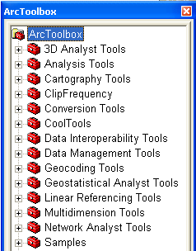
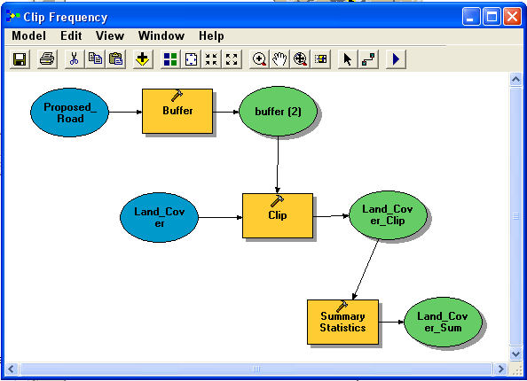
Tools and Framework
Tools
  Perform essential operations on data
  Learning tools enables you to solve real- world problems
Framework
  Mechanics of using, managing, and
  publishing tools
  Automating workflows by creating new
tools - models and scripts

Slide 5
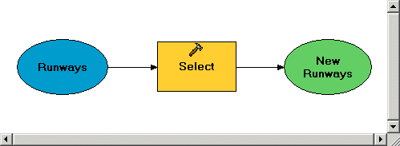
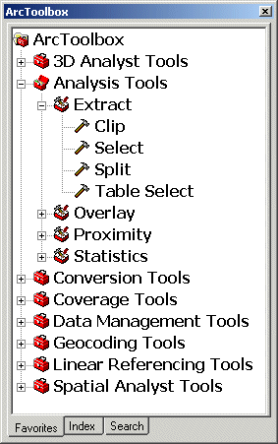
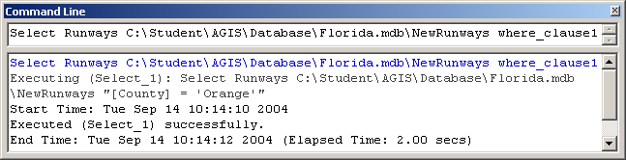
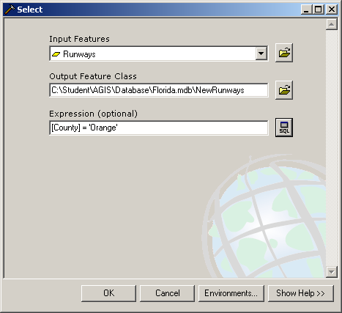
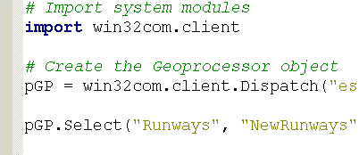
Framework
Four ways to use tools
Models
Command Line
Tool dialog
Scripts

Slide 6
Demo 1
Create a new toolbox, add new tools/model
Build a model
Run the model within ModelBuilder
Add more processes and run them

Slide 7
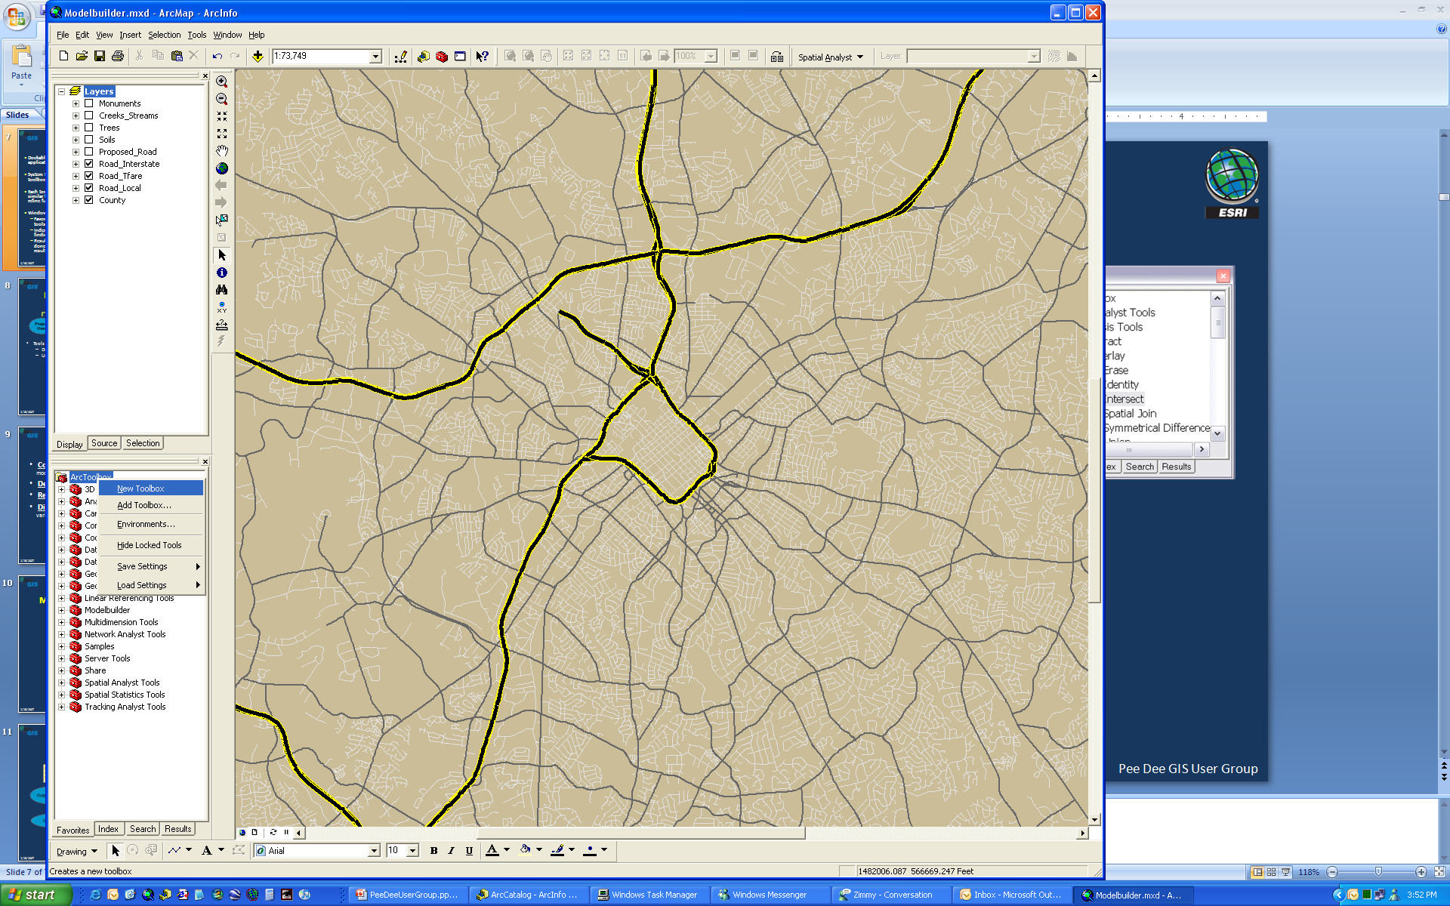
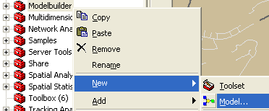
ArcToolbox Basics
Dockable window in any ArcGIS application
System tools organized into toolboxes and toolsets
Each toolbox contains tools with similar functionality. Toolsets refine further.
Window has four tabs
Favorites – tree-view of all tools
Index and Search – assist in finding tools
Results – logs what you’ve done and helps manage tool results
Show/Hide ArcToolbox Window

Slide 8
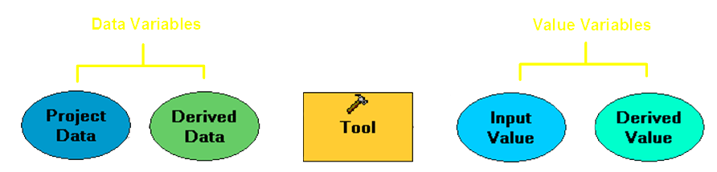
Demo Review
Model elements
Tools
Drag and drop into window
Use Add button
Data
Drag and drop into window
Drag and drop onto tools
Fill in dialog
In ArcMap, from the TOC
Use Add button

Slide 9
Elements can be:
Copied/pasted within the same model, and other models
Deleted - remaining elements become “not ready to run”
Renamed - only changes the label not the name
Disconnected from a tool (exception: derived data variables)

Slide 10
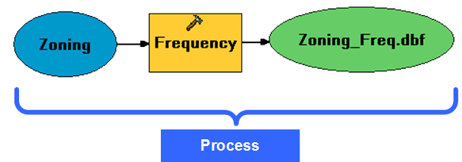
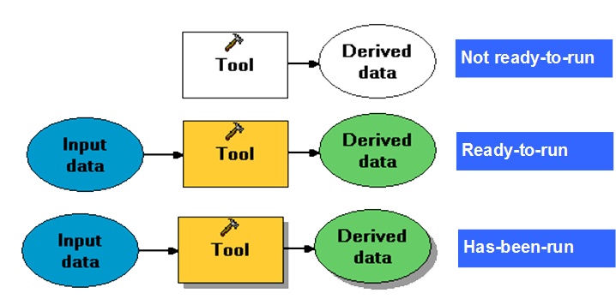
Demo Review
Model process and process states

Slide 11
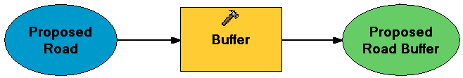

Demo Review
Derived data
Project Data – data you provide to the model
Derived Data – data created by tools in the model
In/Out Derived Data – input data updated by tool

Slide 12

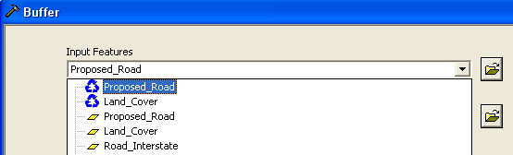
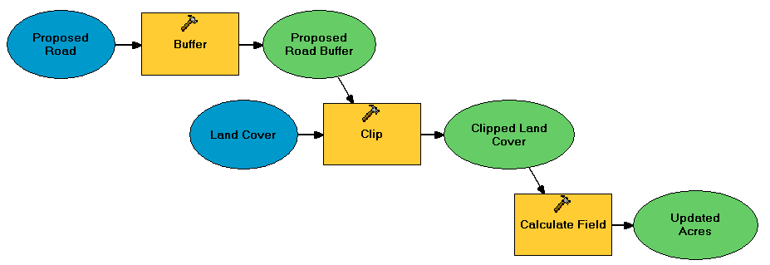
Demo Review
Connecting data and processes
There are two ways you can connect data elements to tool elements, either by using the Connect tool or the tool's dialog
To connect processes, connect the output of one process to the input of another

Slide 13
Demo Review
Execution messages
Status messages can be viewed in:
Progress dialog and Command Line window (if opened)
Right-click on process and View Messages
Reports
For each model, it shows:
The parameter values specified
The time the tool was run
The status of the execution
The time the tool finished executing
Execution errors messages

Slide 14
Demo 2
Run the model from ArcToolbox
Create and use parameters
Changing model properties

Slide 15
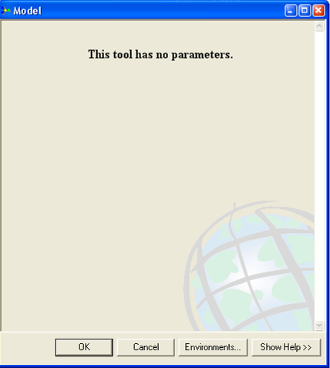
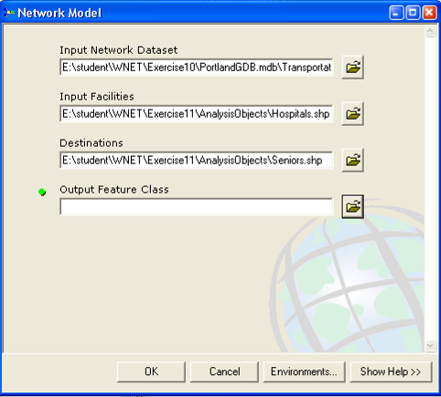
Running a model
From a dialog box
Double-click on the model from ArcToolbox
If there are no model parameters, just click OK in the dialog
If there are model parameters, populate what is required, then click OK to run the model

Slide 16
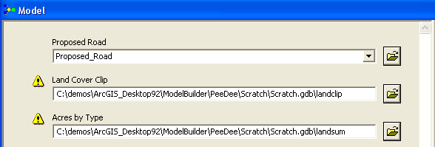
Demo Review
Model parameters
P
Model parameters will
Have a “P” next to them
P
Element name becomes
parameter label in dialog box
P

Slide 17
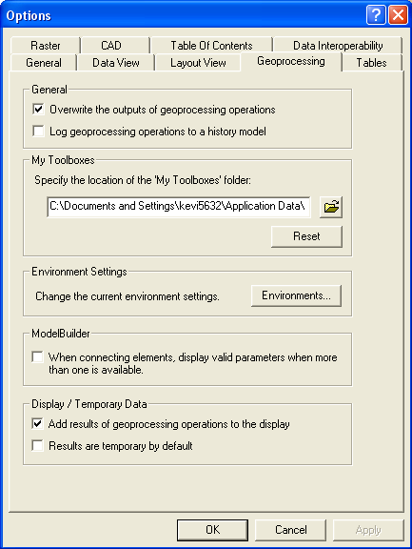
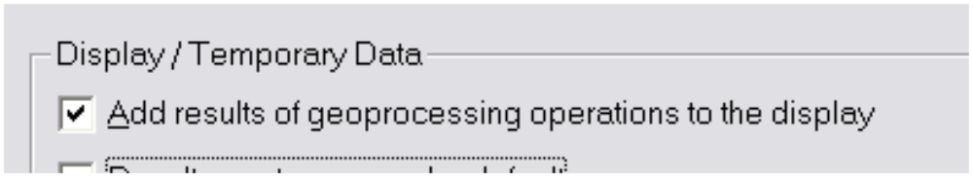
Demo Review
Adding Results
Tools > Options > Geoprocessing tab > Add results…
All OUTPUT parameters will be added to map

Slide 18
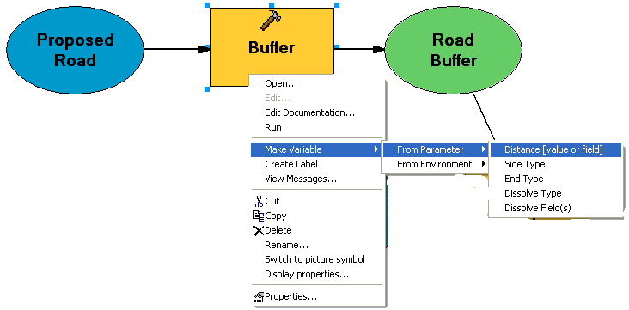
Making variables
ModelBuilder will create a variable for all input datasets
  You decide which tool arguments to expose as variables
  Any variable can be made a model parameter
Right-click tool: Make Variable > From Parameter
  Then set variable as a model parameter

Slide 19
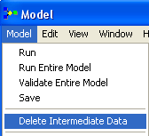
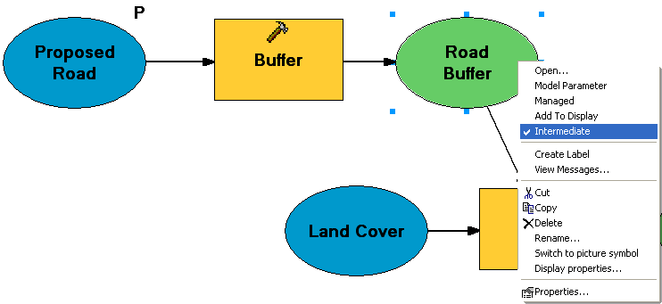
Intermediate data
You decide to how to handle intermediate data
Data marked as intermediate:
  Is deleted after model run as a dialog from ArcToolbox
  Is flagged but NOT deleted automatically if model is run from ModelBuilder window

Slide 20
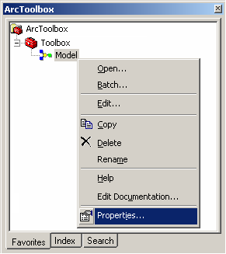
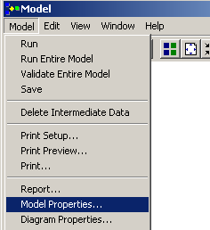
Model properties dialog
Choose Model Properties on the tools context menu, or
In the MB window: Model menu > Model Properties

Slide 21
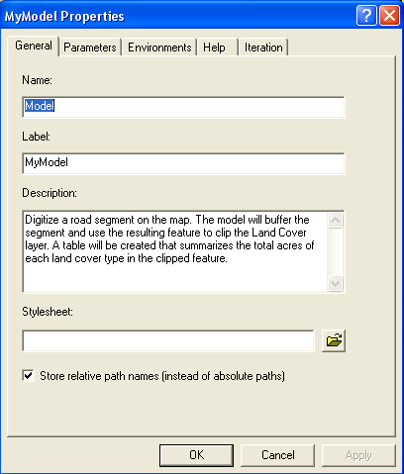
Model properties
General
Modify the name, label, description, and style sheet
Specify relative vs. absolute paths

Slide 22
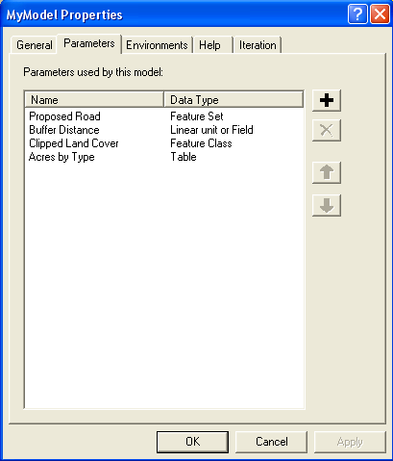
Model properties
Parameters
Add, remove, or change the order of exposed parameters

Slide 23
Demo 3
Add Feature Set input
Symbology
Sharing Tools

Slide 24
Feature sets and record sets
Interactive input of features
  Example: Allow the user to click a point on the map to buffer rather than using a point feature class as an input
Stored “in memory”
Schema taken from existing data or layer
  Feature type
  Fields
  Must have a schema

Slide 25
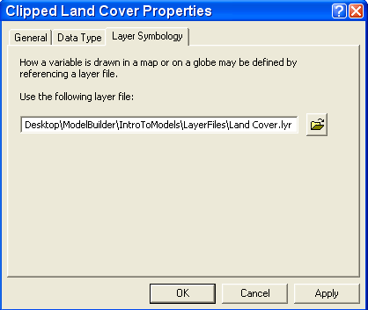
Symbology
Derived from layer file (.lyr)
Used for result

Slide 26
Sharing tools
How data is used in the tool
All variables have values. Can be run w/in ModelBuilder (all processes ready-to-run). All data accessible.
  Data conversion tool that expects a certain file format and always writes to same location.
Some data variables have values. The data is accessible. Cannot be run within ModelBuilder (some processes not-ready-to-run)
  User enters an address, a five-mile buffer around address created and used to clip known data.
Completely generic – no data variables have values. Cannot be run within ModelBuilder
  Like a system tool that takes any dataset.

Slide 27
Performance Tips
Helping your models
Use “in-memory” workspace
  in_memory\feature
Avoid coordinate transformations
Add attribute/spatial indexes
Reduce data size
Use ESRI GRID raster format

Slide 28
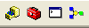
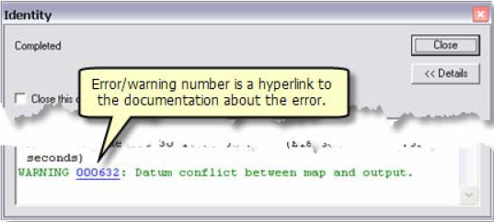
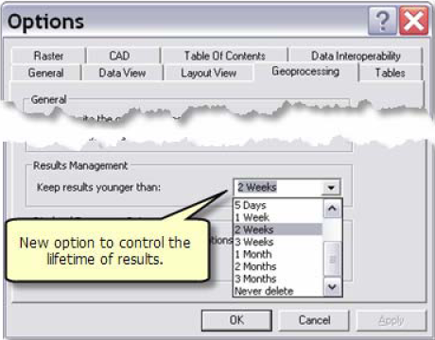
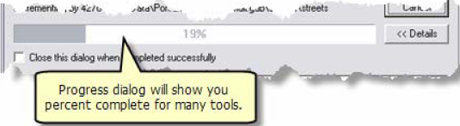
New at 9.3
Start ModelBuilder button on Standard Toolbar in Desktop
Improved Error Messages
Results Management
Progress Bar

Slide 29
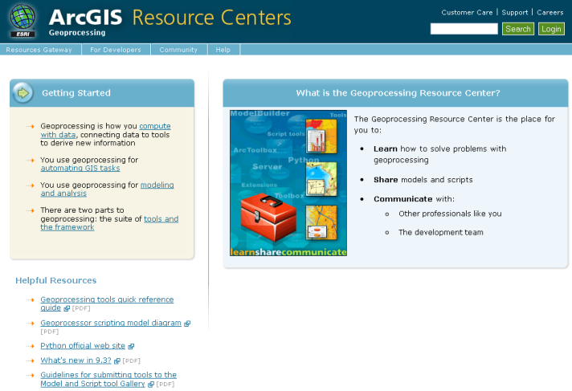
ModelBuilder Support
Online
http://resources.esri.com/geoprocessing
http://arcscripts.esri.com
ArcGIS Desktop online help
Virtual Campus
Geoprocessing using ModelBuilder*
Geoprocessing CAD data with ArcGIS*
Author & Publishing Geoprocessing Services*
Geoprocessing with ArcGIS Desktop
Getting Started with Scripting in ArcGIS 9*
Instructor-Led
Introduction to ArcGIS II
Advanced Analysis with ArcGIS
Introduction to GP Scripts with Python
Writing Advanced GP Scripts with Python
* free course

Slide 30


Announcing SERUG 2010!
April 26th-April 28th
Charlotte, North Carolina
Notes:
Notes: Font: Arial, Size: 8, Text: Wrap

Slide 31
Westin Charlotte
601 S. College Street
Charlotte, NC 28202
Keynote - Bernie Szukalski, ESRI
Registration Open!
Map Gallery Submissions Online
Post Training—Register Early!
http://www.esri.com/events/serug/
Notes:
Notes: Font: Arial, Size: 8, Text: Wrap

Slide 32
SERUG 2009 Stats…
425 Attendees
39 Exhibitors in Solutions Expo
48 User Presentations (60 abstracts submitted)
14 ESRI Tech Sessions
38 Map Gallery Submissions
24 Students in Post-Conference Training
Notes:
Notes: Font: Arial, Size: 8, Text: Wrap

