Slide 1

South Carolina Department of Natural Resources
Flood Mitigation Section
South Carolina
Map Modernization Initiative Update
Pee Dee GIS Users Group Meeting
February 24, 2010
Florence, SC
Daryle L. Fontenot, PE, CFM
Project Manager, AECOM

Slide 2
National Flood Insurance Program (NFIP)
Flood Insurance
  Property owners in participating communities purchase flood insurance
Floodplain Management
  Participating communities adopt and enforce flood damage prevention ordinance
Flood Hazard Mapping
  Develop flooding limits
Notes:
Flood Insurance
Flood insurance is a local program with a national presence
Communities (incorporated and unincorporated) have to join the program before property owners to purchase federally subsidized flood insurance
A community has to remain in good standing for the individual property owner’s flood insurance to remain in force.
Therefore the community is the real building unit of the entire program
Floodplain Management

Slide 3
Map Modernization
Nationwide, 5-year, $1 billion program
Update FEMA’s Flood Insurance Rate Maps (FIRMs) for the nation’s
Produce quality maps
Reduce map production time
Reduce cost/time for future updates
Produce seamless, nationwide flood data
Notes:
Comment on MNUSS and MNA here.

Slide 4

Risk MAP
(Mapping, Assessment and Planning)
Through collaboration with State, Local, and Tribal entities, Risk MAP will deliver quality data that increases public awareness and leads to action that reduces risk to life and property
Notes:
4

Slide 5
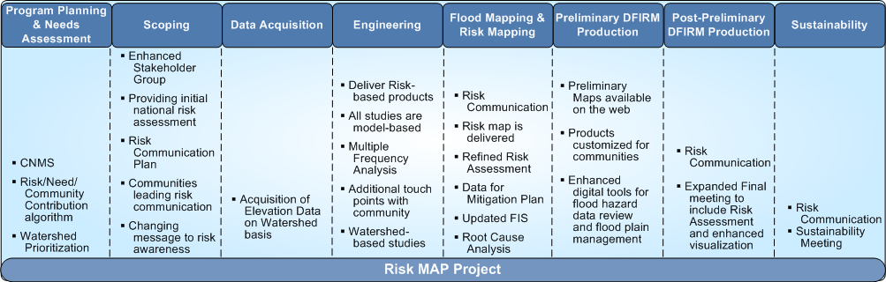
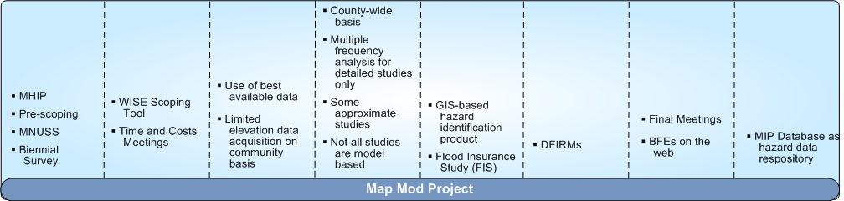
Risk MAP Builds on Map Mod

Slide 6
Why SC Is Undertaking This Project
Property owners will be more accurately informed of flood risks, and will be able to make informed decisions when purchasing flood insurance
Accurate, up-to-date flood hazard information crucial to protect lives and property
Notes:
Updated floodplain mapping is one of the most effective forms of mitigation. There are many communities where millions of dollars of development occurs in the floodplain on a yearly basis. Having incorrect floodplain data could result in hundreds of millions of dollars of damage and disaster relief for these areas in the future.

Slide 7
SC Flood Mapping Program
Program established to implement the Cooperating Technical State Partnership with the Federal Emergency Management Agency (FEMA)
Ownership and responsibility for Flood Insurance Rate Maps (FIRMs) delegated to State
Education local entities on the Map Modernization process, nature and purpose of their study, intent of use of data collected, and post-preliminary process
QA/QC of all mapping products
Notes:
SC Became a CTP in 1999 and has performed the mapping needs assessment for FEMA
SC would like to play a stronger role in preparing and maintaining the maps for the entire state

Slide 8
SCDNR Map Mod Team
Outreach Coordinator – Vacant
State NFIP Coordinator – Lisa Jones
Compliance Specialist – Maria Cox
Engineering & Mapping Lead – Feleke Arega & Masaaki Kiuchi
State Hydrologist – Bud Badr
LiDAR Lead- Jim Scurry
Lead Engineering Firm
  AECOM and URS

Slide 9
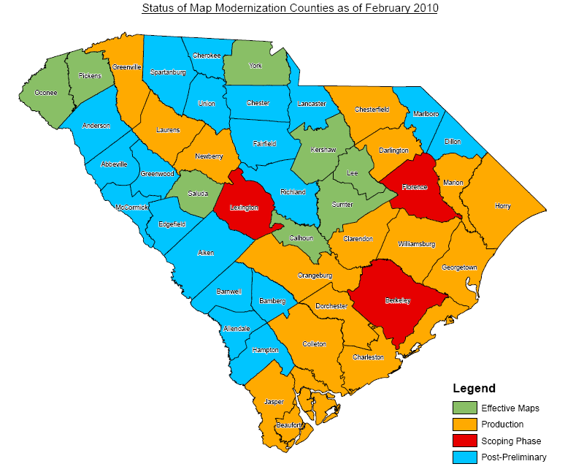
Flood Study Status

Slide 10
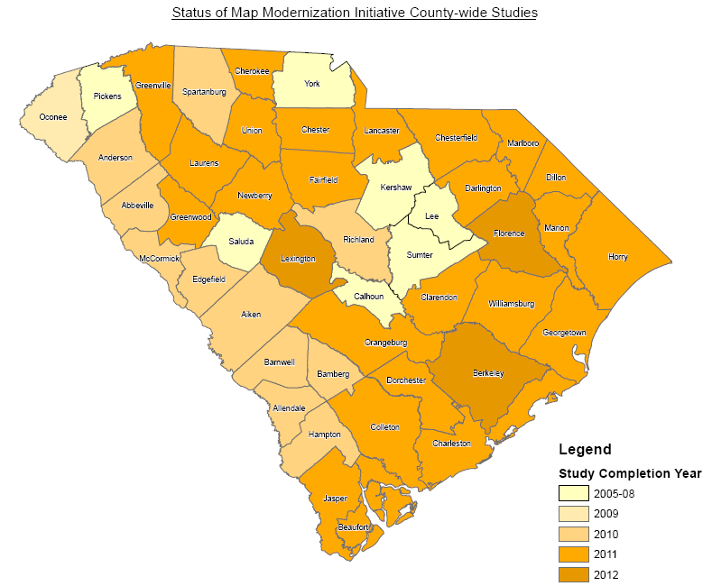
Flood Study
Completion Schedule

Slide 11
Study Process
Scoping/Information Search
Base Map Acquisition
Terrain Data Acquisition
Field Survey
Hydrology
Hydraulics
Mapping
Reporting

Slide 12
Study Process Overview
Base Map Selection
DFIRM Production
Project Scoping
Conducted
Hydrology & Hydraulic Studies
(Includes Coastal modeling|)
PDCC
Meeting
Post Preliminary Processing (12-18 months)
FIS Report Preparation
(Typically 9 – 12 months)
Preliminary Map/Report Production Phase
(Typically 18 – 24 months)

Slide 13
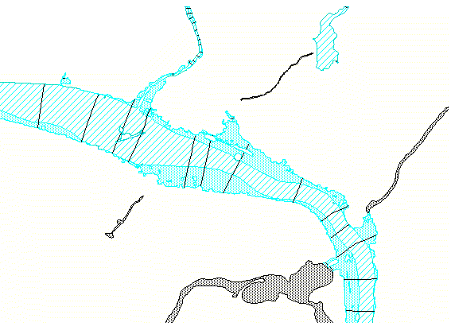
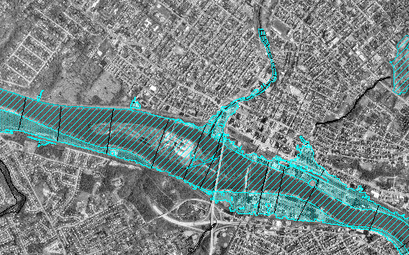
Digital FIRM
+
Topography
+
Flood Data
Base
=
Digital FIRM

Slide 14
Information Search
Research on historical floods in
each county
Coordination with other agencies for High Water Mark Information and recent projects

Slide 15
Factors for Study Priorities
Areas of existing or anticipated development
Area where new road crossings have been built
Areas affected by flood-control structures and/or channelization
Areas where natural physical changes in the floodplain have been significant
Areas that were studied by approximate methods and unmapped areas, especially those with development pressure

Slide 16
Factors for Study Priorities (cont.)
Areas where the community has experienced flooding outside mapped floodplains, with severe damage to buildings and/or infrastructure
Areas where mapped flood hazards do not match those shown on contiguous FIRMs
Areas where flood data (BFEs, floodplains, and regulatory floodways) are likely to be changed the most by a restudy

Slide 17
Coordinated Needs Management Strategy (CNMS)
CNMS
  Initiative to update the way FEMA organizes, stores and analyzes flood hazard mapping needs information for communities
  Provides an approach and structure for the identification and management of flood hazard mapping needs that will provide support to data driven planning and flood map update investment process in a geospatial environment.
  Goal is to produce a national inventory database of flooding sources corresponding to our mapped inventory and to begin referencing mapped flooding sources as validated or as having an unmet need
  Three phases to program to be completed and integrated into the Risk MAP program by FY2011:
    Phase I – National summary map
    Phase II – Stream level inventory
    Phase III - Stream level validation

Slide 18
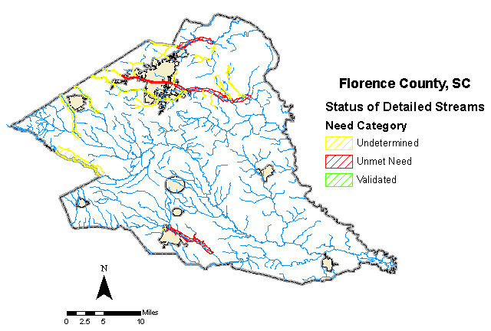
CNMS
A spatial Geodatabase that tracks the community’s needs and requests for FEMA-funded flood studies.

Slide 19
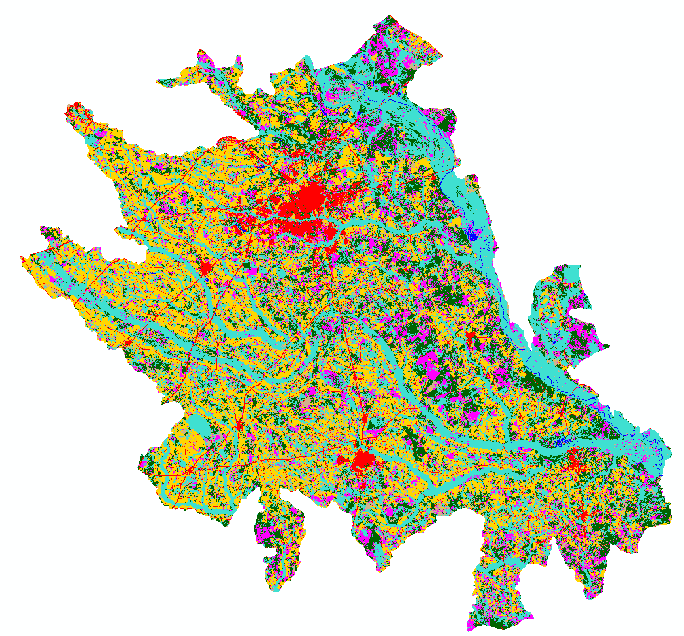
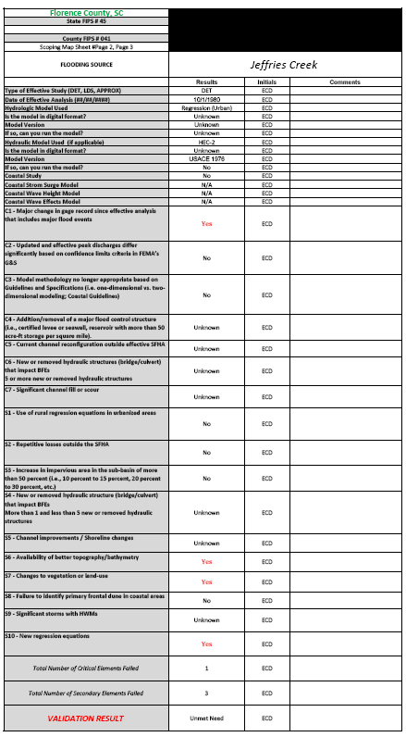
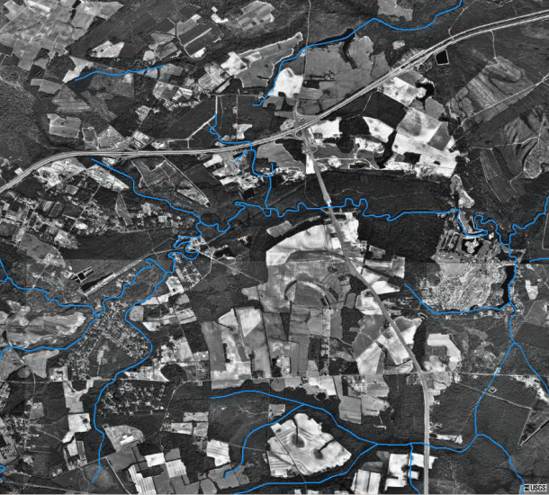
CNMS Validation
The model validation process utilizes remotely sensed & aerial photos to analyze changes with land use & stream channels.
➔

Slide 20
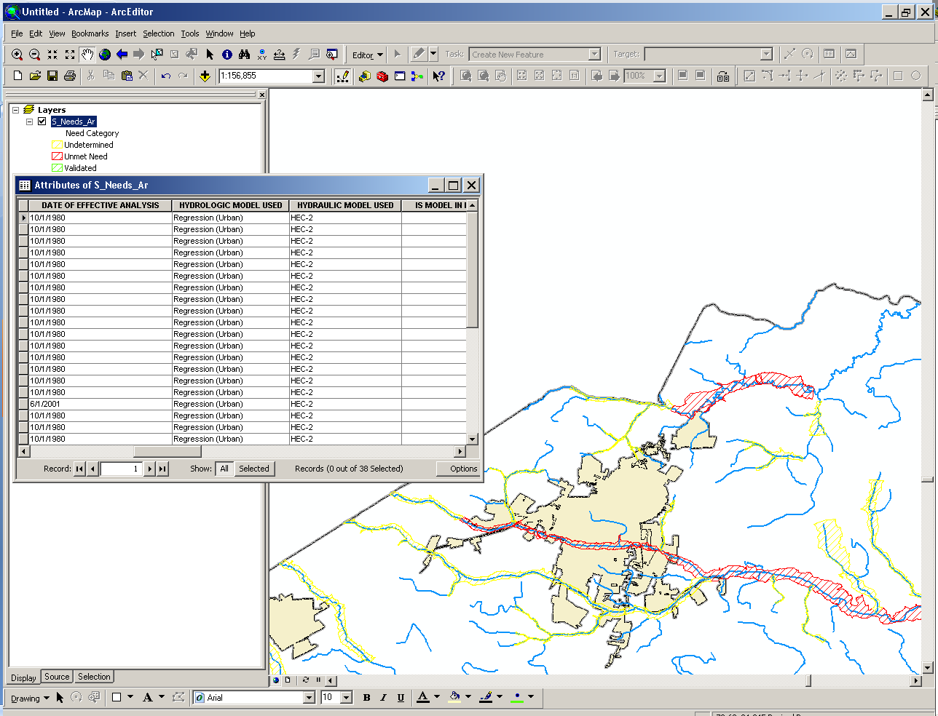
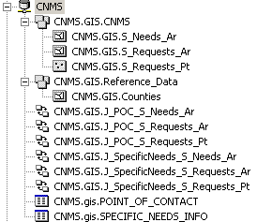
CNMS Database
Validation criteria for detailed streams are populated & associated with need polygons in CNMS GDB. Streams with invalid models are tracked as “Unmet Needs” along with studies requested by the community that are not funded.

Slide 21
Base Map Information
Base Map Sources
  County or State Provided Imagery
  USGS DOQQ

Slide 22
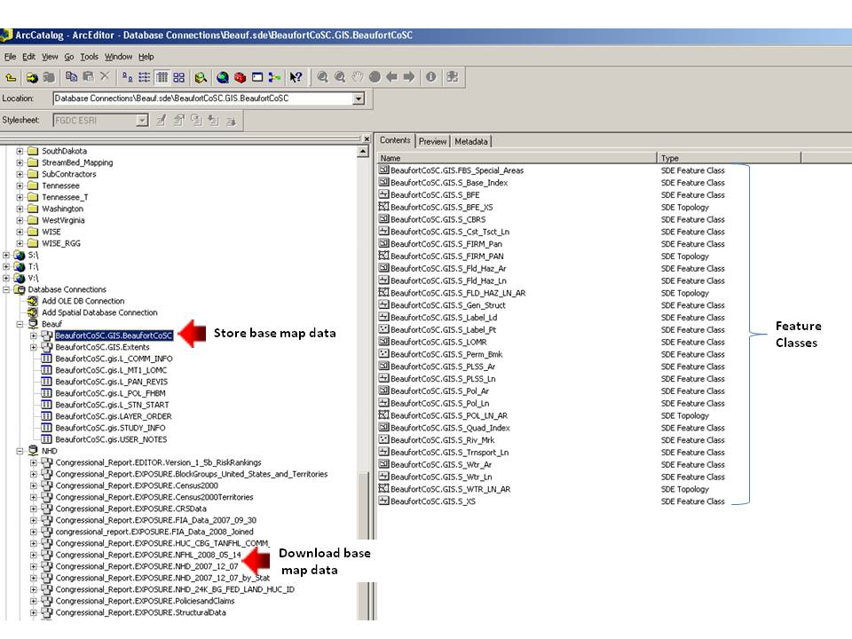
Base Map Information Store and Download Data

Slide 23
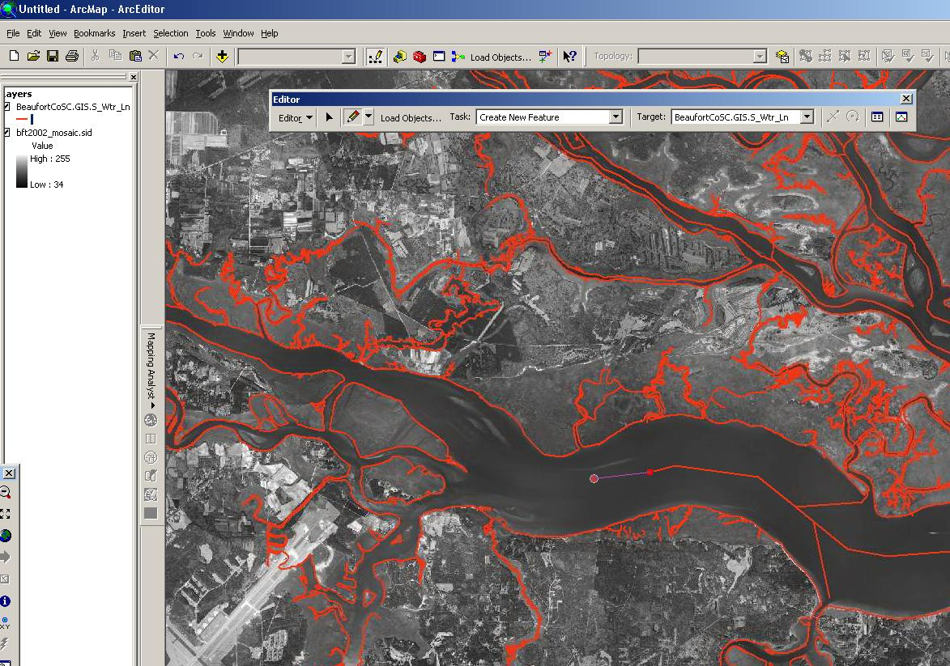
Base Map Information Capture /Digitize Waterline and other Data

Slide 24
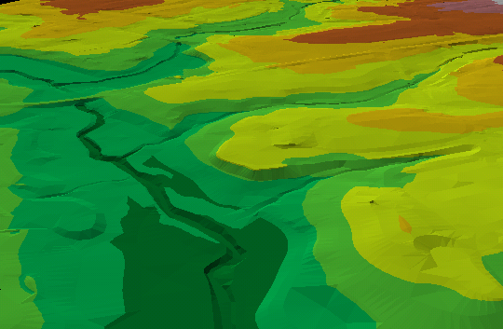
Terrain Data
Building block for hydrology & hydraulic study
Source - Existing topographic data from each county
New LiDAR data

Slide 25
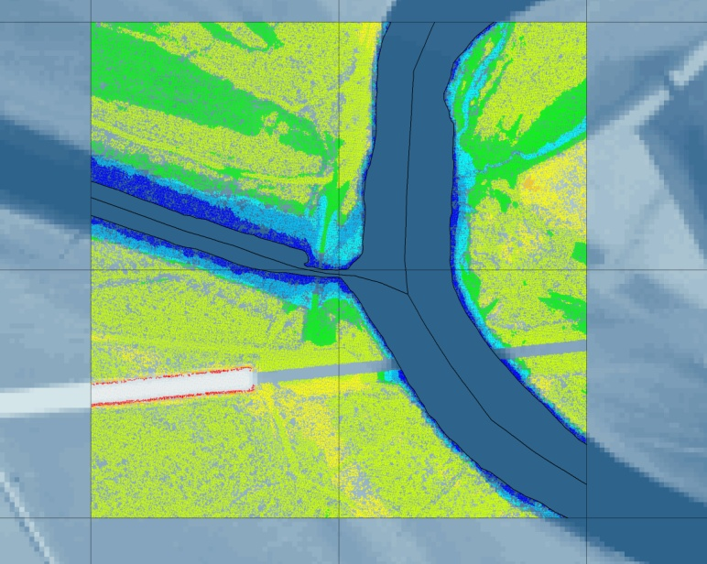
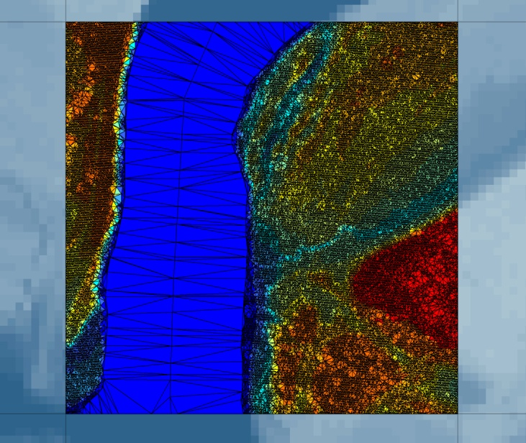
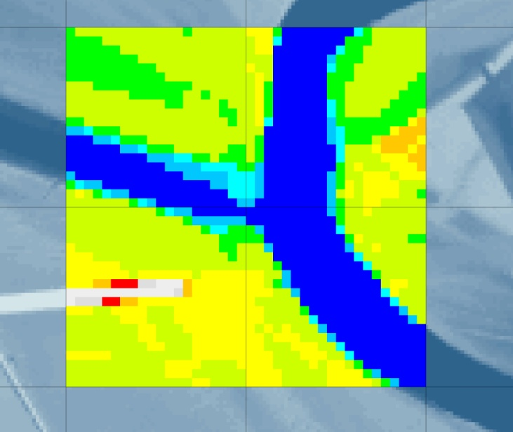
WISE Terrain Analyst: DTM to TIN to DEM
Terrain Data
Notes:
The basic workflow to create a terrain project is to import the raw bare earth data (LiDAR and breaklines) into the WISE/WTA application. The software then builds a triangular irregular network (TIN) from the bare earth points and lines. The TIN surface model is the most accurate representation of the topography. The software simultaneously samples a digital elevation model (DEM) from the TIN. For most flood studies, we sample the DEM at 50ft postings.

Slide 26
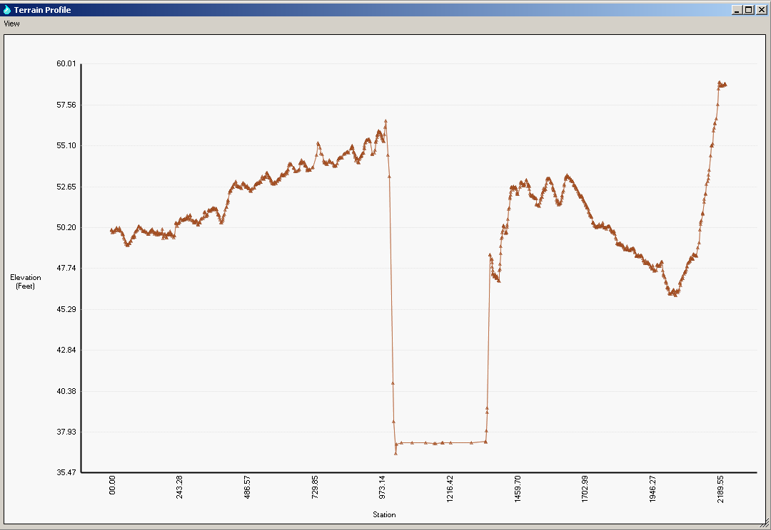
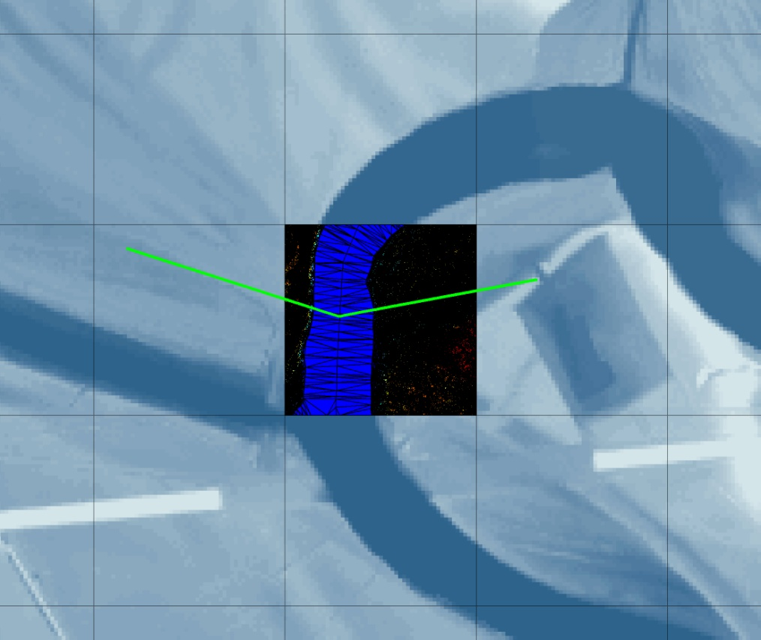
TINs for Hydraulics: Cross Sections\Transects, Redelineation, Flood Mapping
Terrain Data
Notes:
The TIN, as the most accurate representation of the topography, is used to retrieve elevation information for hydraulic analysis. Cross sections and transects provide the geometry in order to calculate and map the water surface elevation in a hydraulic model.

Slide 27
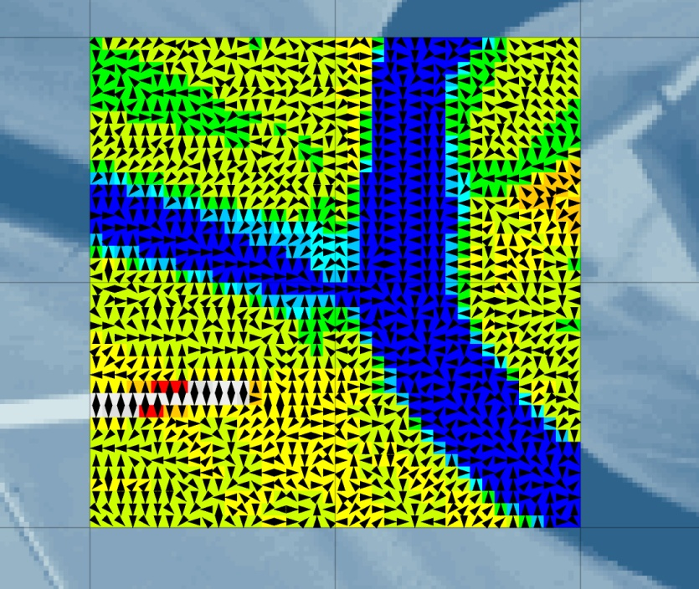
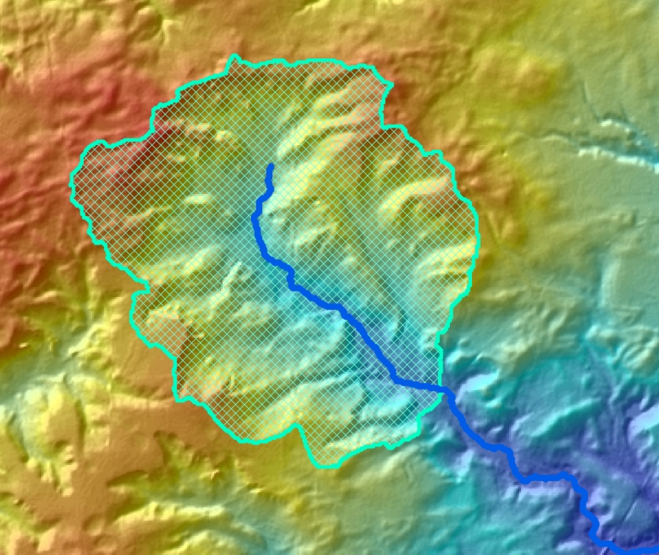
DEMs for Hydrology: Flow Vectors, Drainage Area Calculation, Basin Delineation
Terrain Data
Notes:
The DEM is sampled from the TIN at a nominal post spacing. This grid is edited to hydro enforce the terrain model. Flow vectors, incoming neighbors, and drainage areas are calculated for each cell in the DEM. From this information, basins can be delineated and flow accumulations calculated.

Slide 28
Study Methods
Methods for Updated Mapping
  Riverine Detailed Study
  Riverine Limited Detailed Study
  Approximate Study
  Coastal Study
  Redelineation (FEMA Studies and Others)

Slide 29
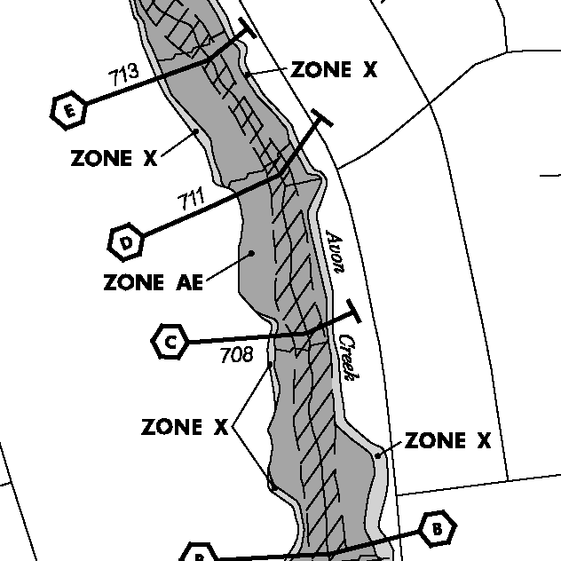
Detailed Study
Traditional Detail Study
Sections Field Surveyed
  Elevation Reference Marks
  Cross Sections
  Historic Interviews
  All bridge and culvert crossings
All Hydraulic Structures Surveyed
Detailed Hydrologic Analysis
Extensive Model Calibration
Traditional Mapping
  Floodways
  Floodway Data Table
  Flood Profile

Slide 30
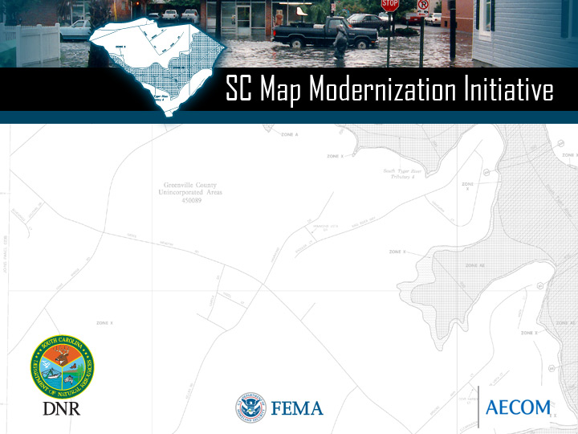
Riverine Modeling Approach
Limited Detailed
Field Survey
Detailed Calibration
Floodway Mapping
Supported by H&H modeling
Hydrology from Regression Equations
HEC-RAS models developed
Calibrated to available data
Floodplain mapped to Terrain data
Detailed Study

Slide 31
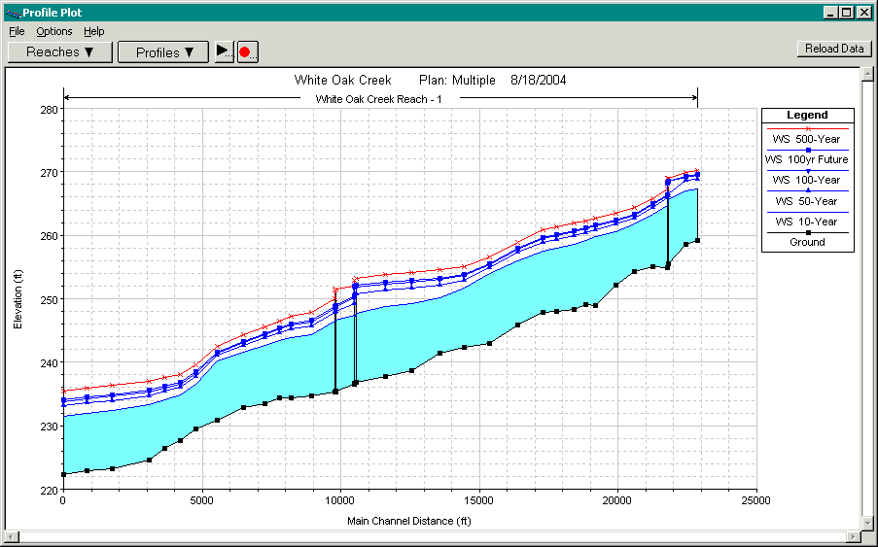
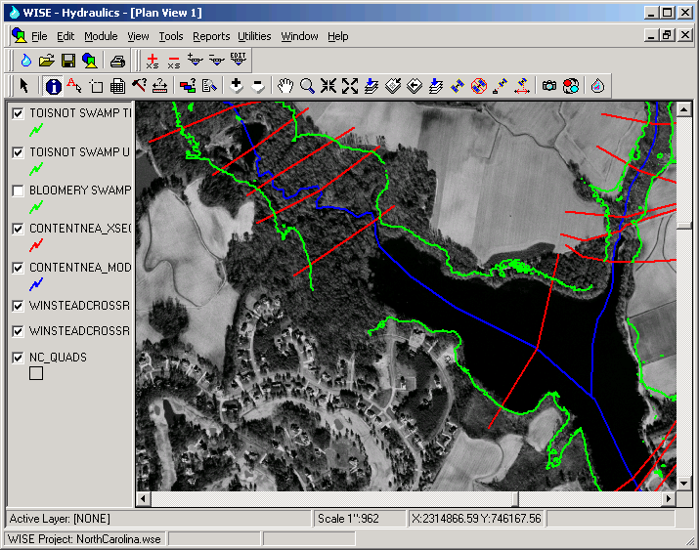
Riverine Modeling
Results from HEC-RAS brought back into WISE
Mapping performed by intersecting WSEL TIN with ground TIN

Slide 32
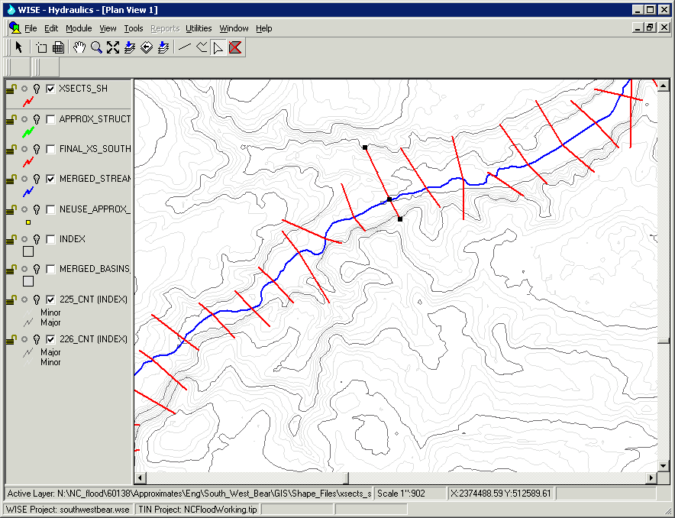
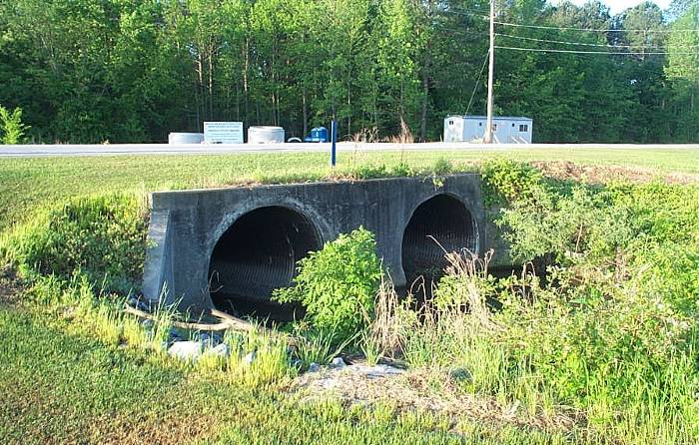
Limited Detail Study
Replaces Unnumbered A Zones
Extend to 1sq. mile or limit of Current Zone A
Topo Data Sources
  USGS 30 meter DEMs
  USGS 7.5 min hypsography
  Local / Countywide Topo Data
  LIDAR
Hydrology Based on Regression Equations (or USGS gages)

Slide 33
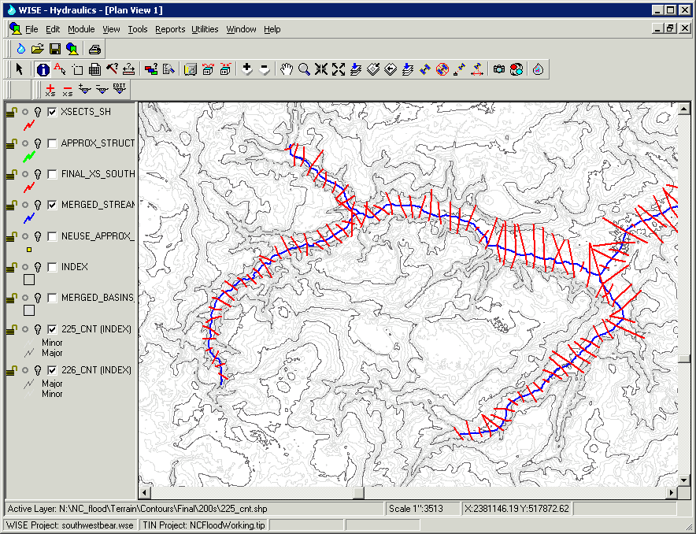
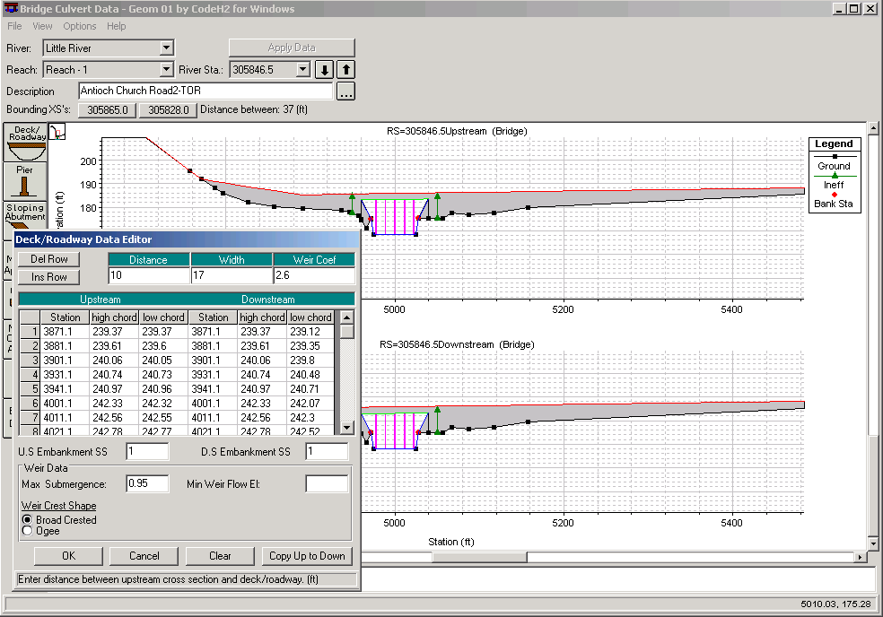
Limited Detail Study
Hydraulic Models Developed
  Hydraulic Structures Measured (No Survey)
  Selected Channels Measured
  Rough Floodway
  Model Review by Engineer
  N-Values
  Ineffective Areas Considered
  Some Calibration

Slide 34
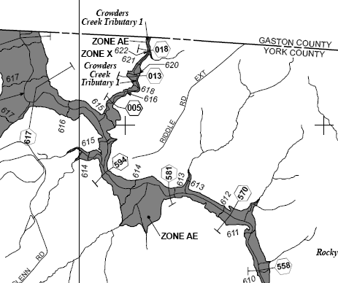
Limited Detail Study
Mapping Details
  Flood boundaries mapped from model output
  BFEs can potentially be shown (as in NC)
  Cross Sections Shown on Maps
  Flood Hazard Data Tables in FIS Report
  Floodways Not Shown
  DFIRM database tables/attributes
  Can be Considered a Zone AE

Slide 35
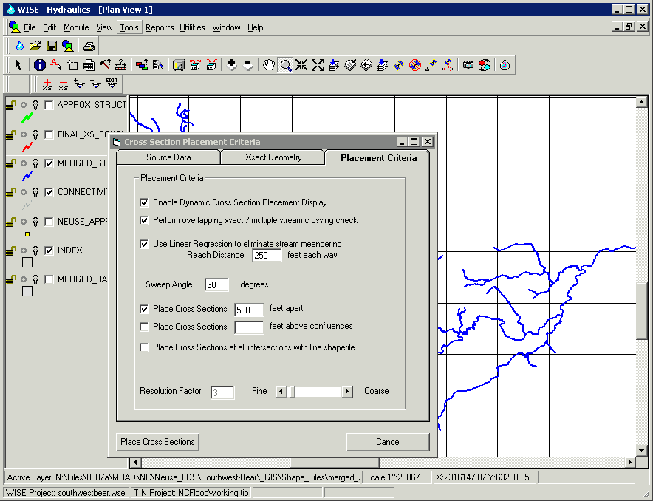
Approximate Studies
Replaces Unnumbered A Zones
Much more automated approach
Hydrology from Regional Equations
Hydraulic Models Developed
  Channel dimensions from rating curve
  A more automated cross section placement
  Standard N-values are used
  No Hydraulic structures are included
  No floodway
  No calibration to High Water Marks
  Limited Model Review / Modifications by Engineer – model defaults accepted

Slide 36
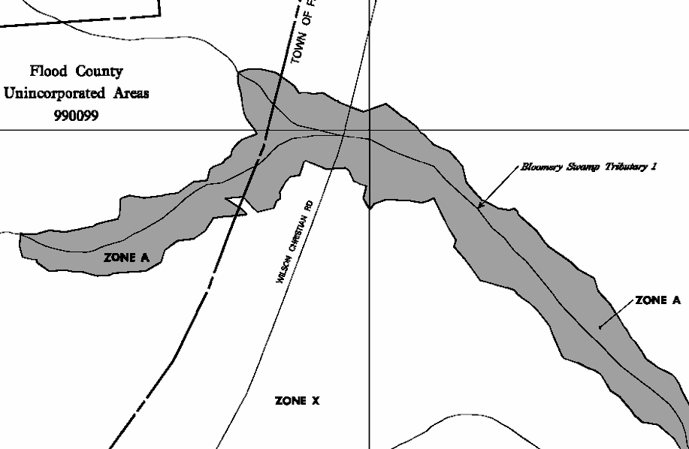
Approximate Study
Mapping Details
  Flood boundaries mapped from model output
  BFEs are not shown
  (can be provided as a GIS layer)
  Cross Sections NOT shown
  Floodways Not Shown
  Is considered a Unnumbered A Zone

Slide 37
Coastal Modeling
Topography
Bathymetry
Stillwater Elevation
  Wave Setup
Wave Runup and Erosion Analysis
Wave Height Analysis
Mapping of Flood Elevations and Zones

Slide 38
Coastal Modeling Approach
Hydrodynamic Storm
Surge Modeling
Stillwater Elevation
Wave Setup
Coastal Flood
Hazard Analysis
Wave Runup & Erosion Analysis
Wave Height Analysis
Mapping of Flood Elevations and
Zones to Terrain Data
Coastal
Detailed Study

Slide 39
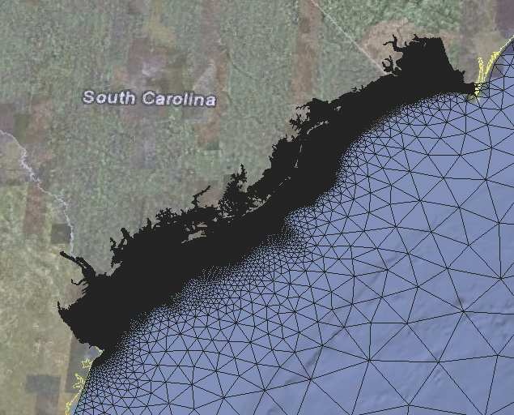
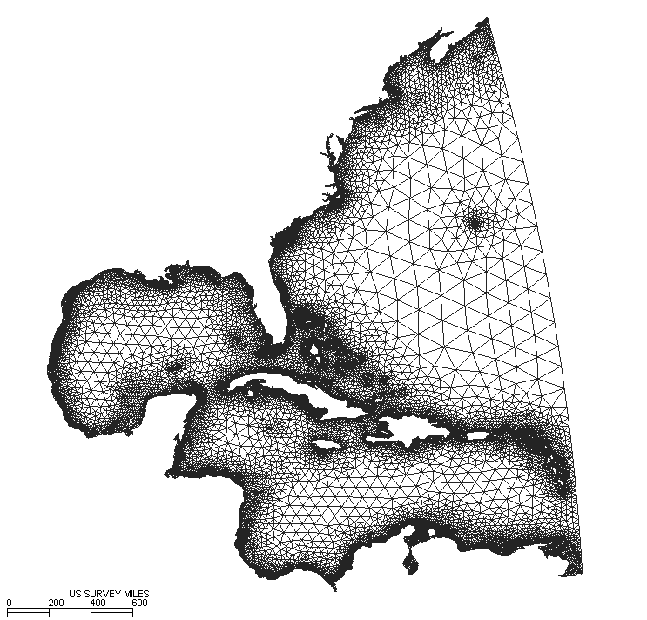
Coastal Modeling Storm Surge
ADCIRC Storm Surge Model Grid
39
Notes:
The ADCIRC is being used to model the coastal storm surge. The grid has approximately 500,000 nodes with about 90% of those concentrated in South Carolina.

Slide 40
Coastal Modeling Storm Surge
(1) Model Validation
Hurricane Hazel
Hurricane Hugo
Hurricane Ophelia
(2) Production Runs
ADCIRC
2D Wave model
(3) Storm Statistics
Produce 10-, 50-, 100-, and 500-yr stillwater plus wave setup values for overland wave modeling
40
Notes:
The next steps in the storm surge modeling are to (1) complete the model validation, (2) run the production runs with the ADCIRC and 2D Wave model, and then (3) compute the storm statistics to develop the 10-, 50-, 100-, and 500-yr stillwater plus wave setup surfaces.

Slide 41
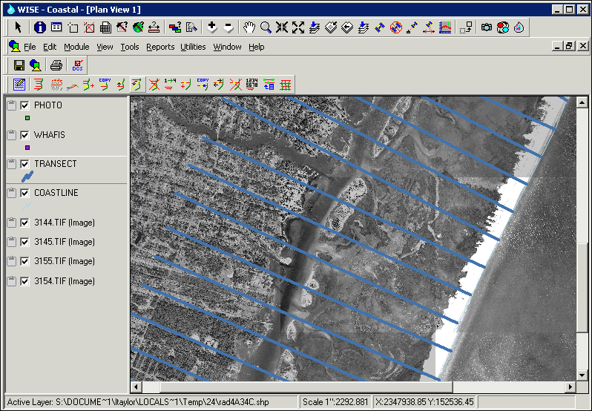
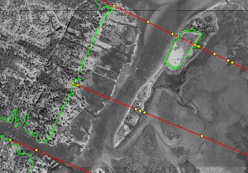
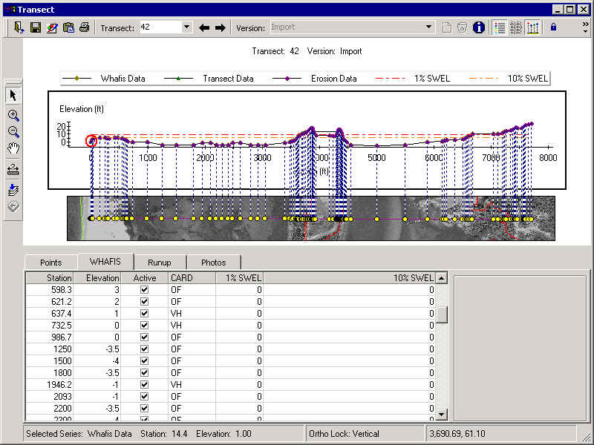
Coastal Modeling Wave Height Analysis in WISE
Erosion
  Calculations automated – much quicker than CHAMP
CHAMP, WHAFIS, & RUNUP
  Exports topo and land use data into CHAMP for WHAFIS & RUNUP
Mapping
  Imports results from CHAMP into WISE for mapping

Slide 42
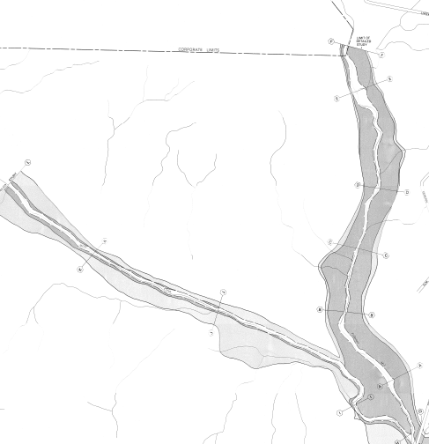
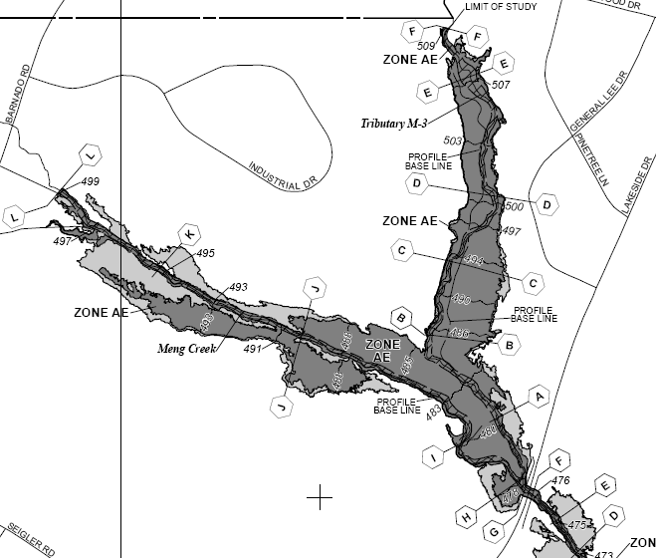
Redelineation

Slide 43
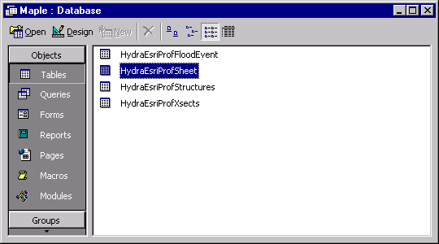
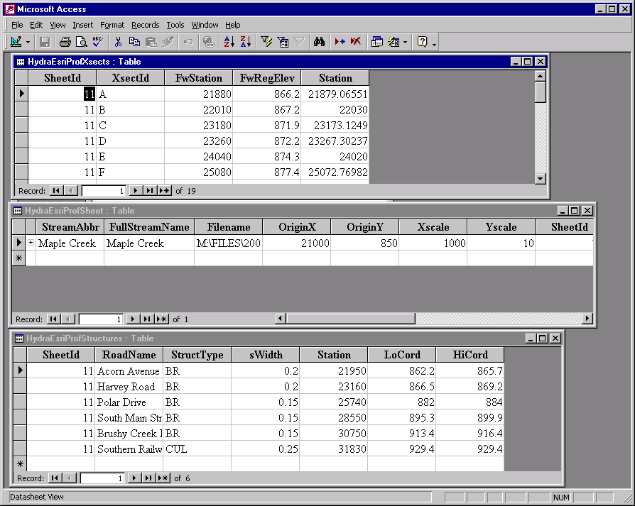
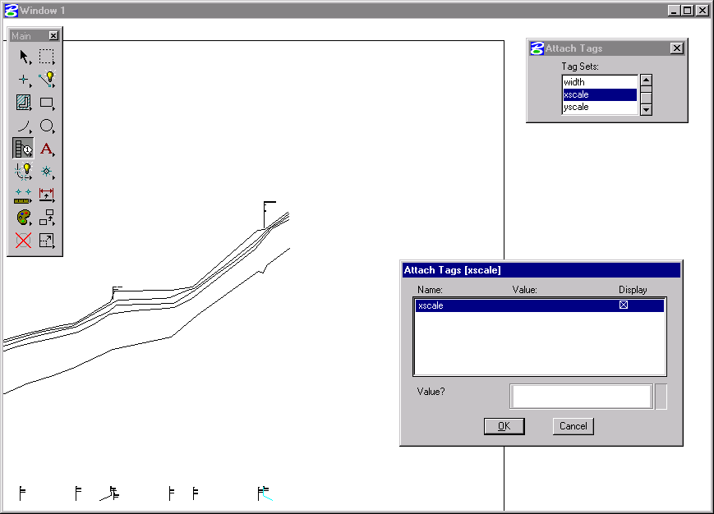
Redelineation
Used to Update Effective Mapping with new Terrain Data
Datum Conversion to NAVD 88 from NGVD 29
Foundation is the FEMA Profile
  Recreated
  QC Checked against FDT
  Datum Shift
Floodways and Cross Sections are Digitized

Slide 44

Redelineation
Stream Stations usually are not adjusted to new topo
FEMA Lettered Sections are supplemented with “mapping sections”
Efforts made to ensure tie-ins to downstream and upstream studies
Notes added to profiles as needed referencing adjacent Limited Detail Studies

Slide 45
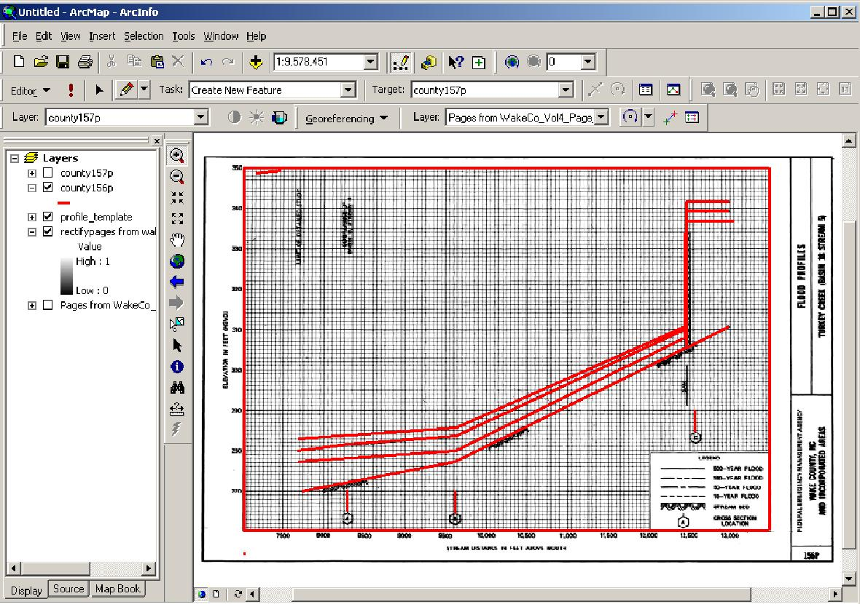
Redelineation Digitize Rectified Profiles

Slide 46
Floodplain Mapping
Fully Automated:
  Mapping of flood boundaries
  Automated creation of profiles
  Placement of BFE’s to FEMA standards
  Generation of Floodway Data Tables
DFIRM product
Notes:
Demonstration of BFE placement.

Slide 47
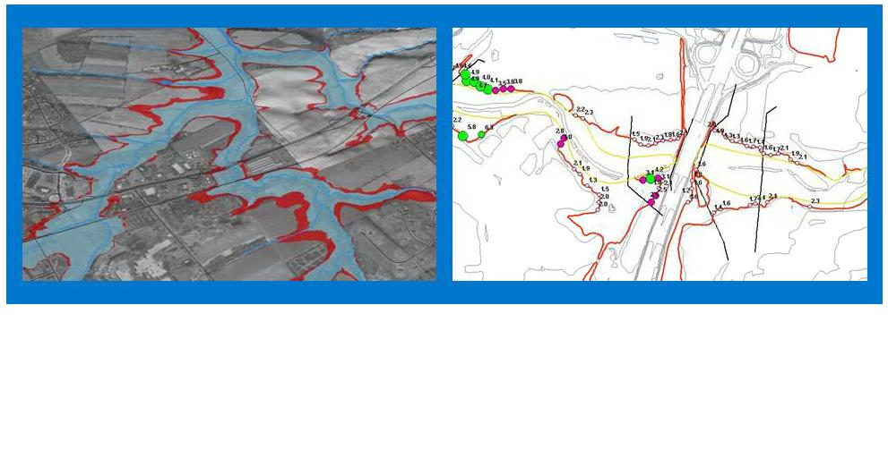
Floodplain Mapping Example of Flooding in GIS and on Map

Slide 48
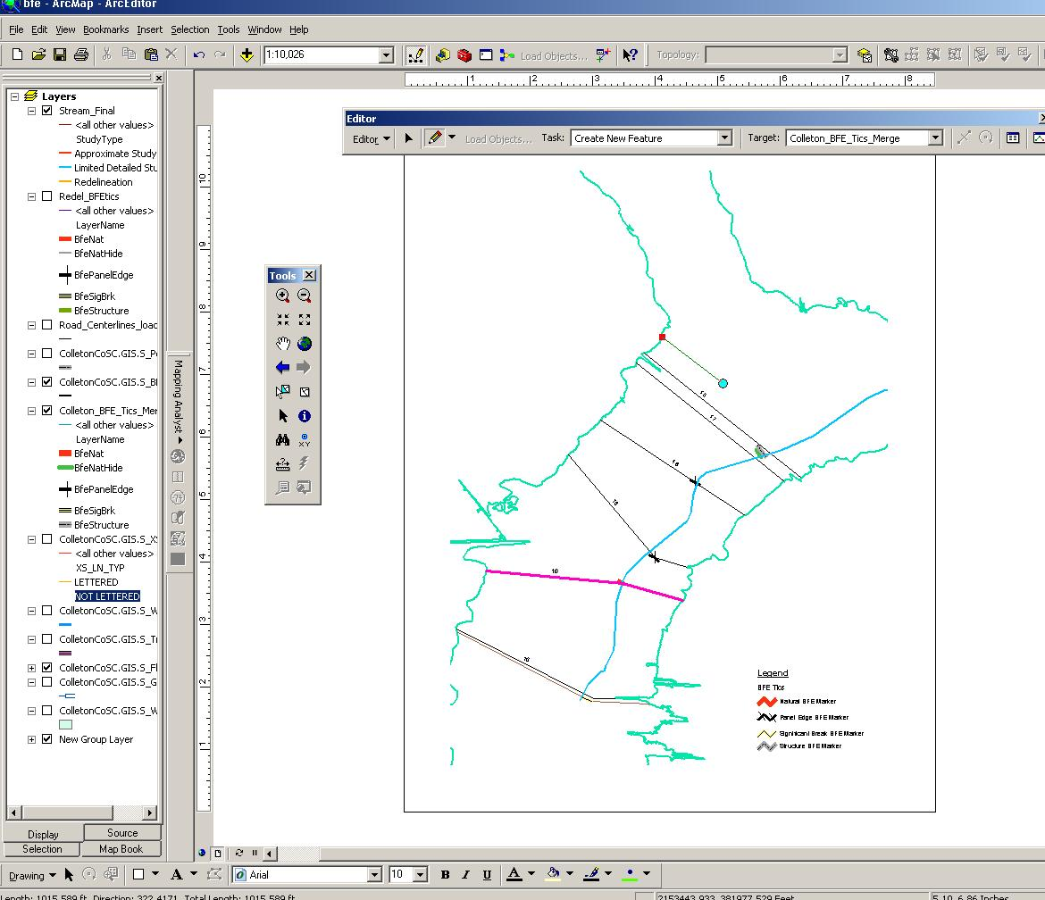
DFIRM Product BFE Creation using Tic Marks

Slide 49
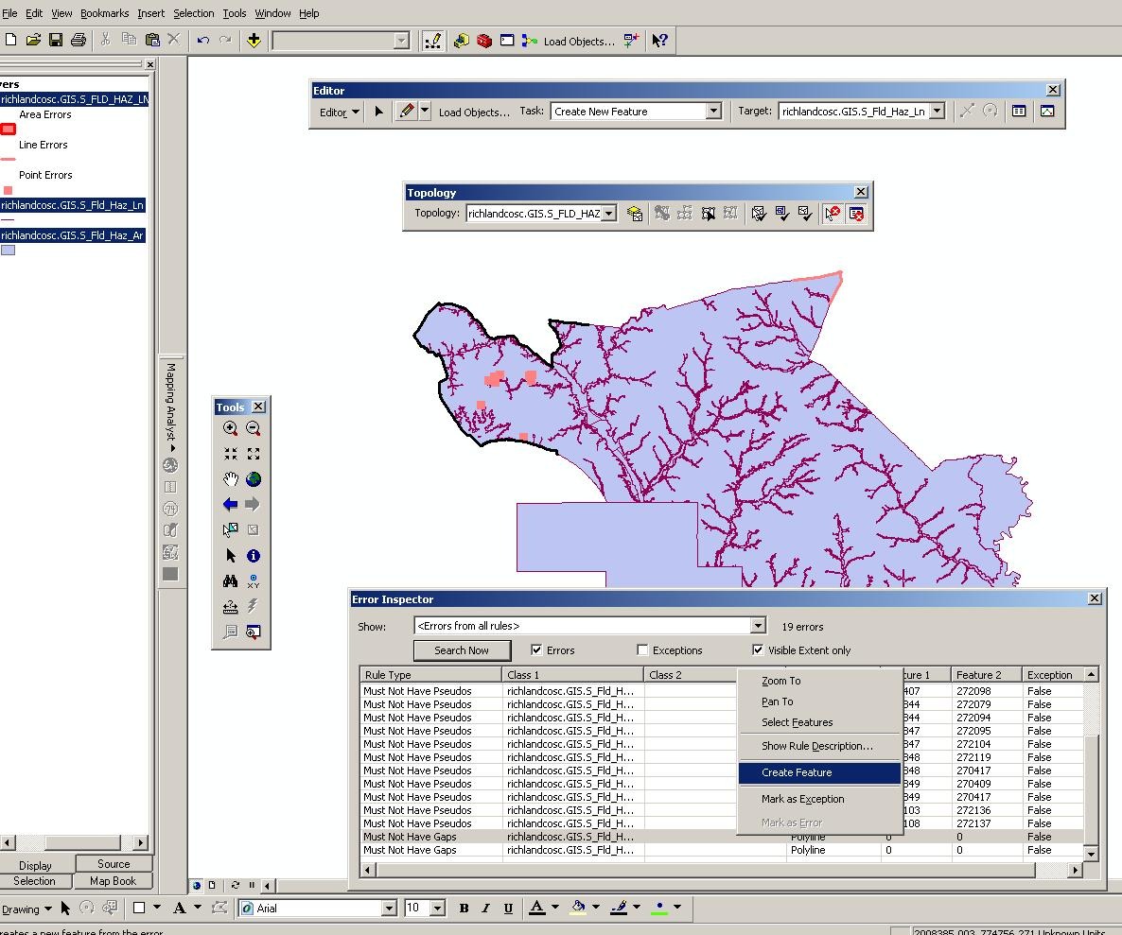
DFIRM Product Topology

Slide 50
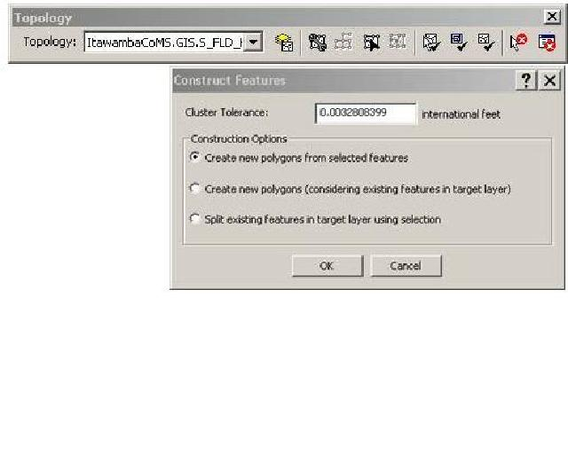
DFIRM Product Create Polys for s_fld_haz_ar

Slide 51
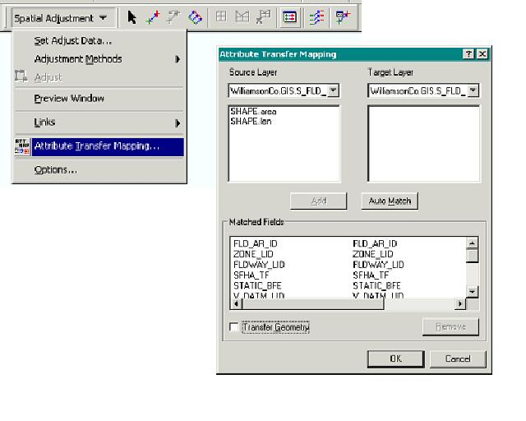
DFIRM Product Attribute Polys with Flood Zone

Slide 52
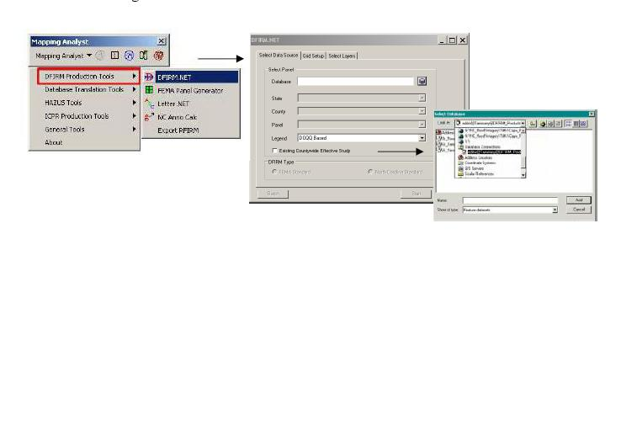
DFIRM Product DFIRM.net Example

Slide 53

DFIRM Product MapText Example

Slide 54

DFIRM Product Label Cleanup

Slide 55

South Carolina DFIRM Product
Notes:
FEMA has developed new DFIRM mapping standards which we have used to complete 5 countywide DFIRM’s this year, including using DOQQ base mapping
8 county studies have gone effective with an additional 15 somewhere in the production or post preliminary stage

Slide 56
100% Digital Submission
Project upload to FEMA’s Mapping Information Platform (MIP)
Project Elements Uploaded to MIP as each Element is completed
Data Availability to Communities

Slide 57

MIP Work Bench

Slide 58

MIP Manage Data Development

Slide 59

MIP Task

Slide 60
QA/QC
Flood Insurance Study Independent QA/QC
QA/QC Checklist for Each Production Step
  Topographic Data
  Hydrologic Data
  Hydraulic Data
  DFIRM
  Floodplain Mapping
  DFIRM Database

Slide 61
PM 42 – Quality Control Requirements for DFRIM Map Production

Slide 62
Flood Study Independent QAQC
Data needed for reviews include (continued):
  GIS layers
    Streamlines
    Basins
    Cross sections
    Structure locations
    Roads

Slide 63
Technical Support Data Notebook (TSDN)
Complete Documentation of Project
All Data Collected
All Analyses & Assumptions
Uploaded into the MIP

Slide 64







Terrain Data
Automated H&H Models
Mapping
Field Surveys

Slide 65

Questions

Slide 66

FINI
Daryle L Fontenot, PE, CFM
Project Manager
D 704.643.0108 x4315
C 704.408.4829
Daryle.Fontenot@aecom.com
AECOM
6201 Fairview Road, Suite 400, Charlotte, NC 28210
F 704.553.6151
www.aecom.com

