Slide 1
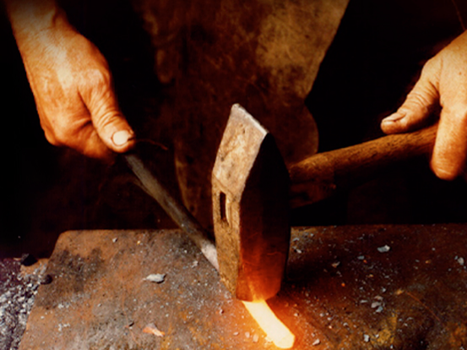
It all started in a blacksmith shop…
Integrity – Quality – Commitment – Innovation
Notes:
It all started as a blacksmith shop more than 170 years ago.
Deere & Company’s amazing longevity and prosperity can be largely attributed to four core values … strong, basic values that were exhibited by company founder John Deere, and have been long adopted by its employees:
Integrity
Quality
Commitment
Innovation
While Deere & Company has grown, these values have remained constant. That’s why we remain successful today and why we will be successful in the future.

Slide 2

Agriculture and Turf
Percentage of population engaged in agriculture
Former Soviet Union 6.8%
Western
Europe 1.7%
U.S. 0.9%
China 38.5%
India
25.4%
Brazil 6.4%
Argentina 3.7%
(Based on data from Food & Agricultural Organization of the United Nations)
Notes:
Worldwide farm economic conditions remain quite promising. Demand for crops is benefiting from a global population that is gaining in both size and affluence, and from a sharp rise in the use of renewable fuels in the United States and other parts of the world.
One hundred fifty years ago, 90 percent of the United States population was engaged in agriculture. Today, that figure has fallen to 0.9% due to mechanization.
With the world population growing by over 8,700 people per hour, and diets being extensively upgraded, demand for grain is expected to triple in the next 50 years and overall food production will need to double … so a tremendous worldwide growth in agricultural equipment is yet to be realized.

Slide 3
2011 Net Sales and Revenues
Agriculture and Turf 75.3%
Construction & Forestry 16.8%
Financial Services 6.8%
Other 1.1%
Notes:
2011 Financials
Worldwide net sales and revenues increased 23 percent to $32.013 billion, up from $26.005 billion in 2010. Net income attributable to Deere & Company was $2.800 billion, up from $1.865 million in 2010.
Values in the chart above represent the percentage of net sales and revenue generated by each division.
Fourth Quarter 2011
Net income attributable to Deere & Company was $669.6 million, or $1.62 per share, for the fourth quarter ended October 31, compared with $457.2 million, or $1.07 per share, for the same period in 2010.
Worldwide net sales and revenues increased 20 percent, to $8.612 billion, for the fourth quarter, compared with $7.202 billion in 2010.
For 2012, net income attributable to Deere & Company is anticipated to be approximately 3.2 billion.

Slide 4

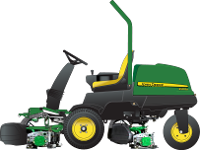



Agriculture and Turf
Global Operating Model
5 Global External Platforms –
A platform consists of a portfolio of ‘like’ product lines
Crop Harvesting
Combines
Front-End
Equipment
Cane
Cotton
Turf and Utility
Utility Vehicles
Riding Lawn
Equipment
Commercial Mowing
Golf
Walk-Behind Mowers
Hay and Forage
Self-Propelled Forage Harvesters
Heads
Balers
Mowing
Crop Care
Seeding
Tillage
Application Equipment
Tractors
Large
(7000, 8000, 9000)
Medium (6000)
Utility
(2000, 3000,
4000, 5000)
Loaders
Notes:
The Agriculture and Turf Global Operating Model consists of five product platforms. Each platform is made up of product lines that serve a similar function in the marketplace. This arrangement aligns product portfolios, leverages engineering and manufacturing capabilities globally, and provides rapid response to market and customer needs.

Slide 5
John Deere Robotics
Meeting customer needs through robotics and telematics.
Labor reduction
Increased safety
Higher efficiency
Reduced input costs

Slide 6
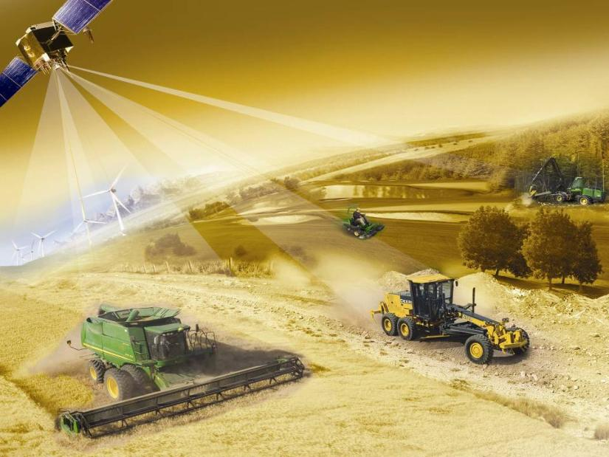
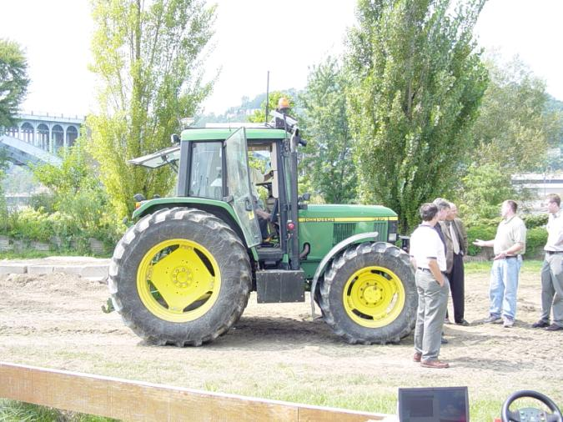
Robotics at John Deere
Now
Then
1996
Deere began large investment in
machine automation. Became AMS (Ag Management Systems) now ISG (Intelligent Systems Group)

Slide 7
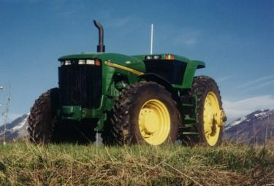
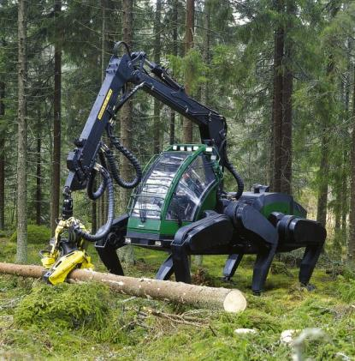
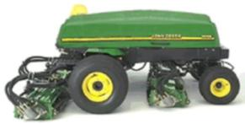
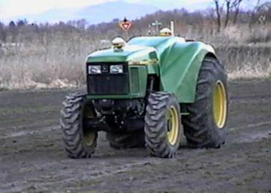
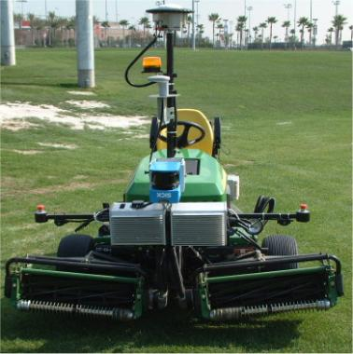
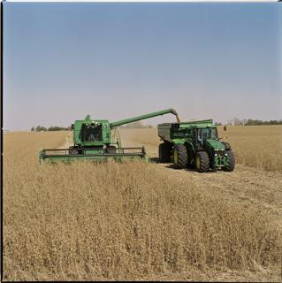
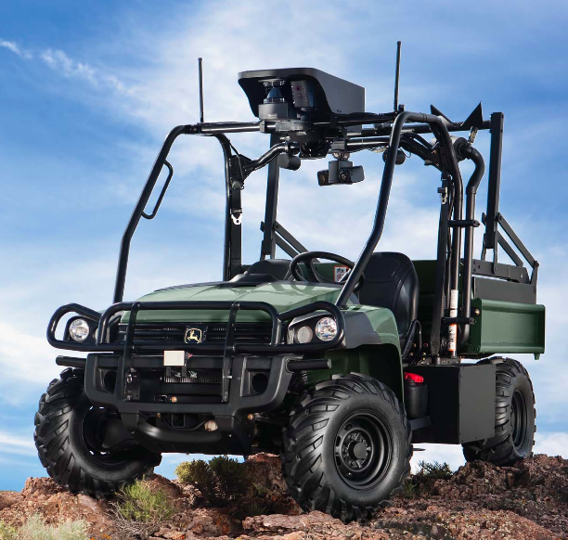
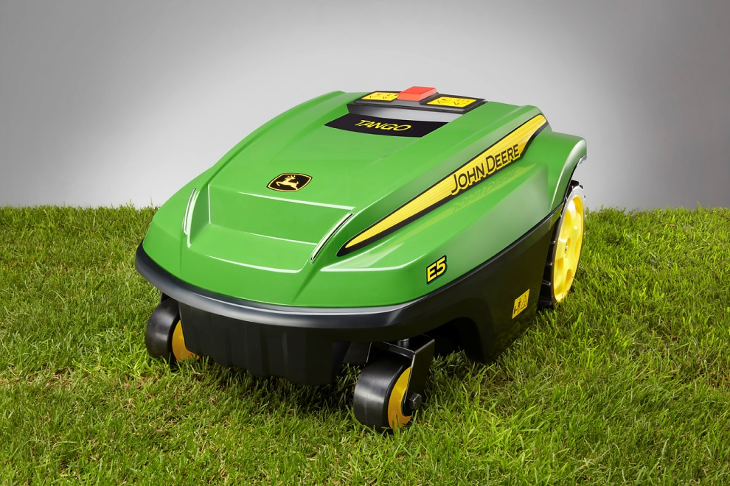
Robotics at John Deere
Notes:
For the last 15 years, Deere has continued to develop robotic equipment

Slide 8
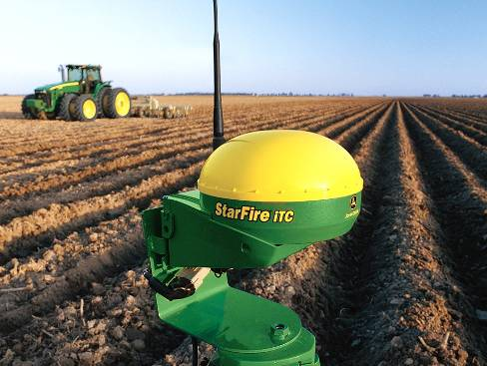


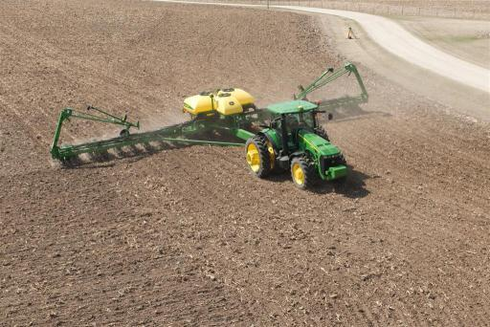
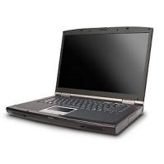

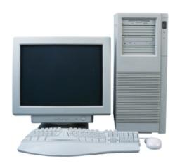
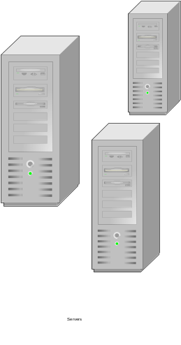
How JDLink™ works
GPS
Operator Assisted
Grain Cart Tractor
Recording
Cellular
Data Server
Notes:
GreenStar, Autotrac, Coordinated Farm
Now lets see how this technology will allow you to provide solutions to YOUR customers that take the guesswork out of:
1) Machine management
2) Communication with your customers’ tractors
3) Utilization and performance
With these exclusive tools, you can provide solutions to differentiate yourself as a sales professional and your dealership as a dealer of tomorrow. And you are adding dollars to the customer’s bottom line, keeping them coming back for more of the smart solutions and services only you can provide.
Grain cart – combine position communicated via radio, tractor positions off of combine

Slide 9
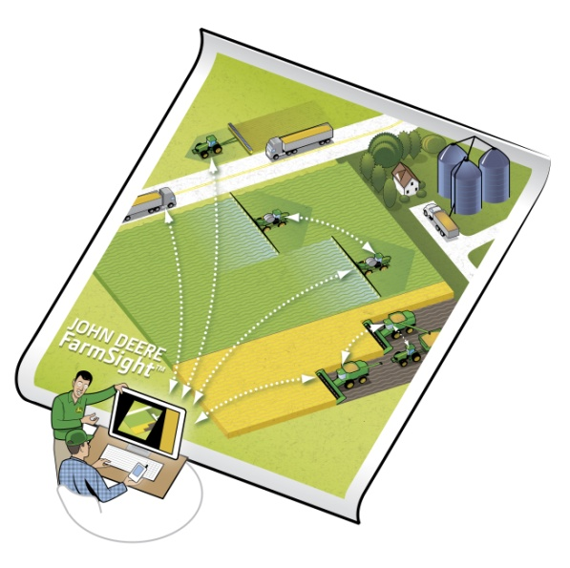
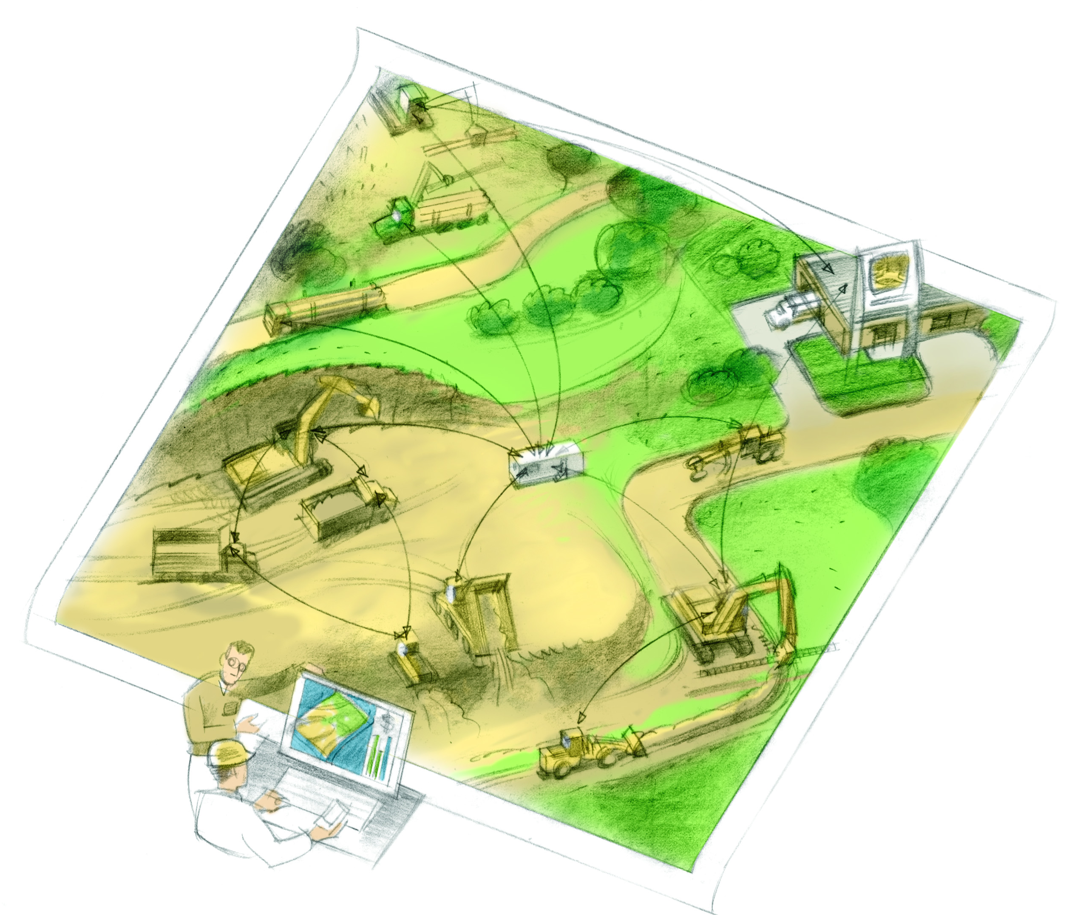
Agriculture & Construction
John Deere FarmSight™
John Deere WorkSight™

Slide 10
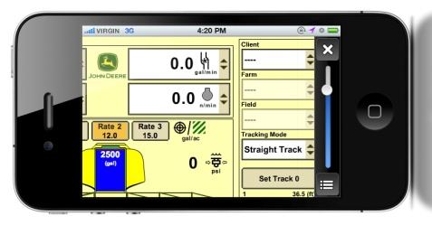
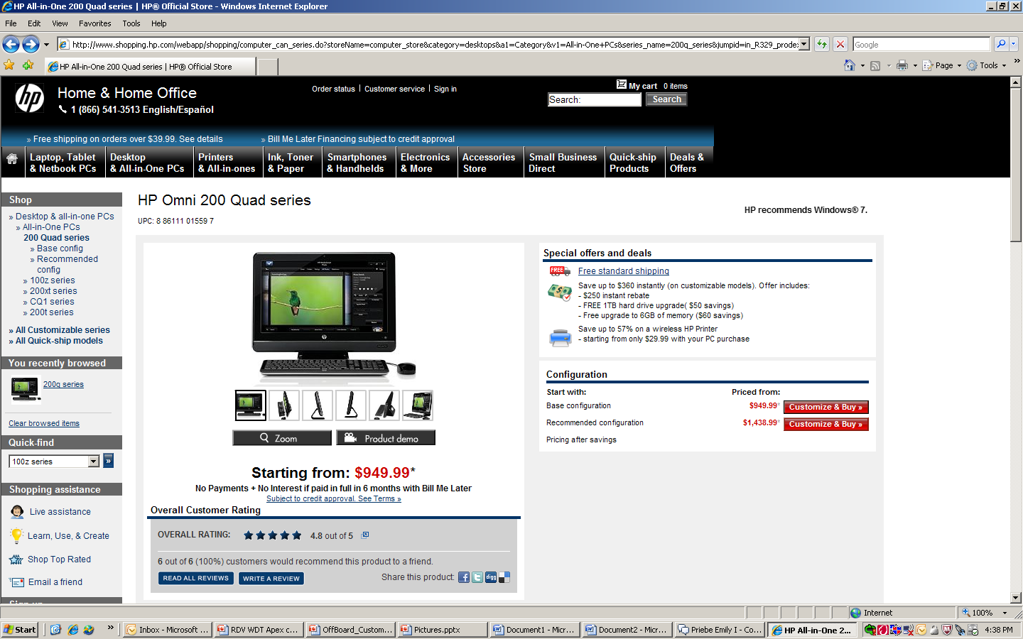
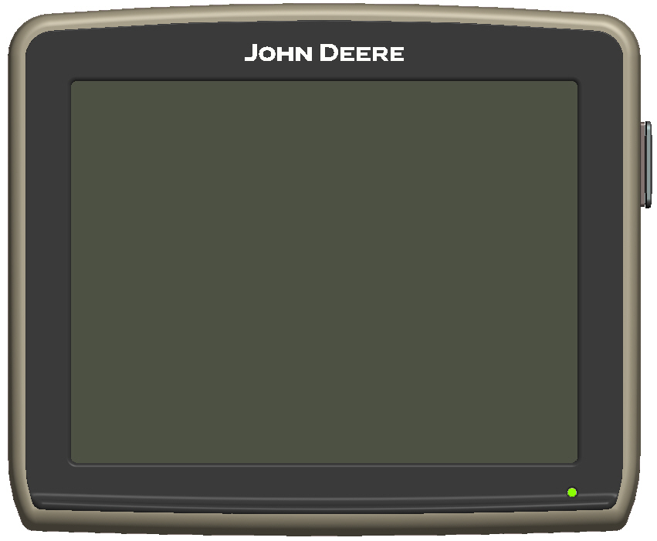
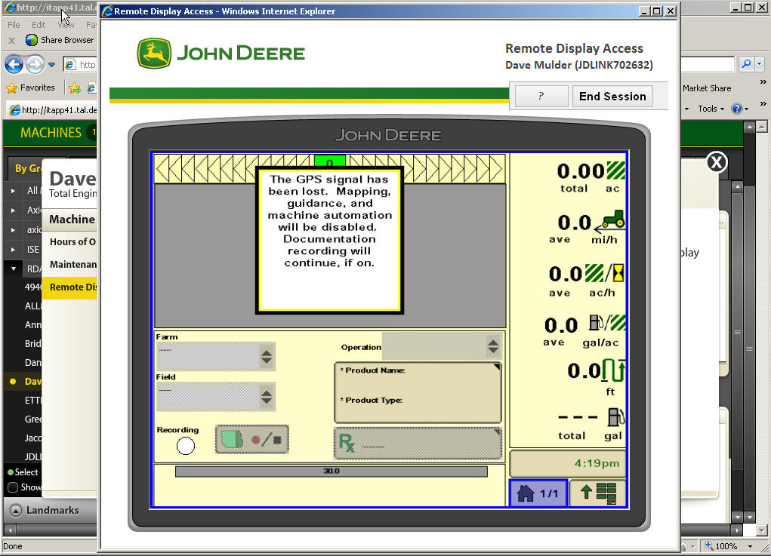
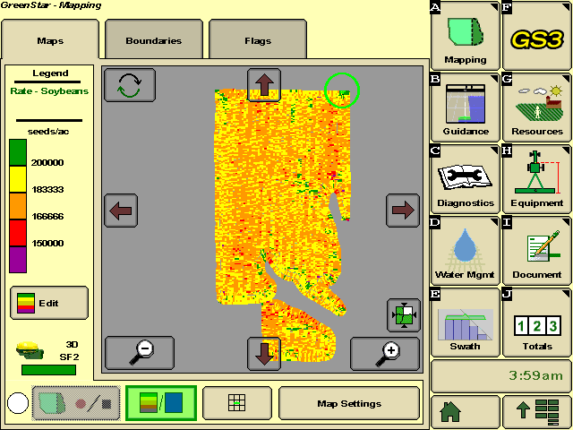
John Deere Remote Display Access

Slide 11
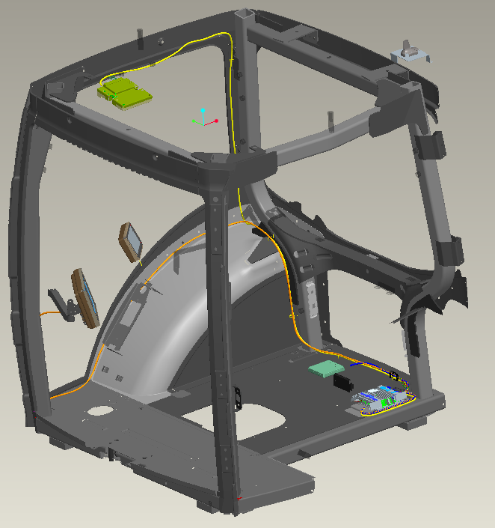
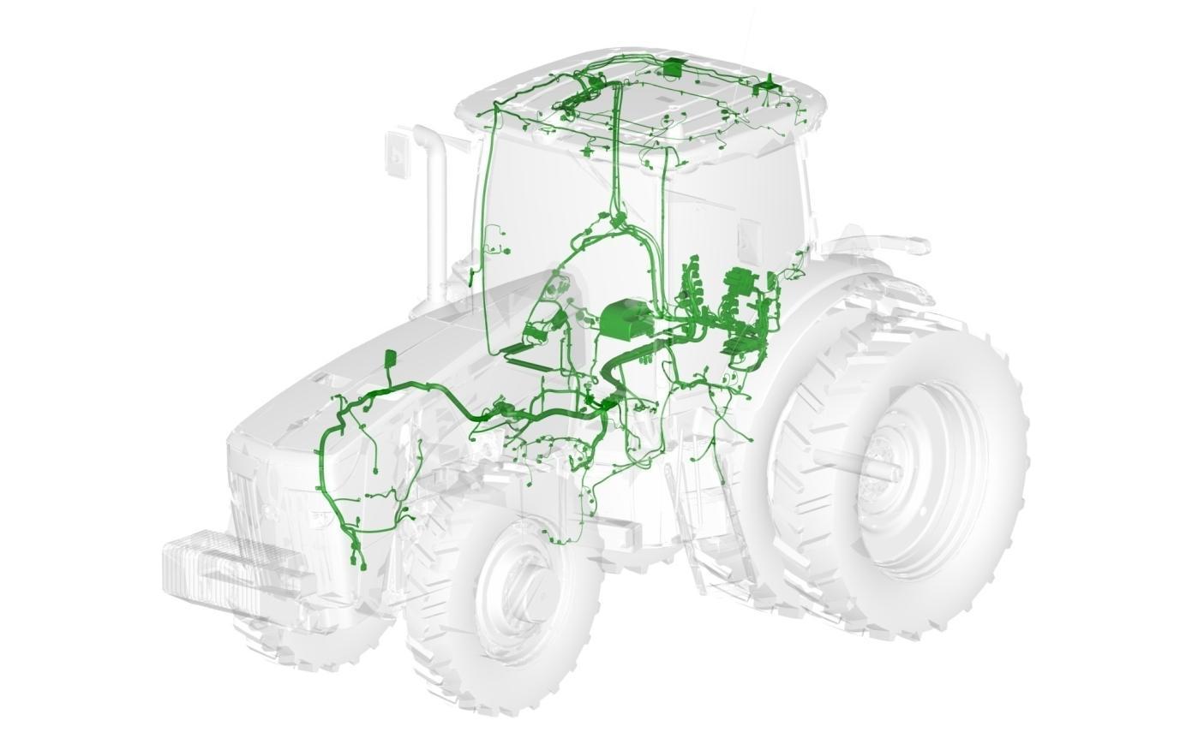
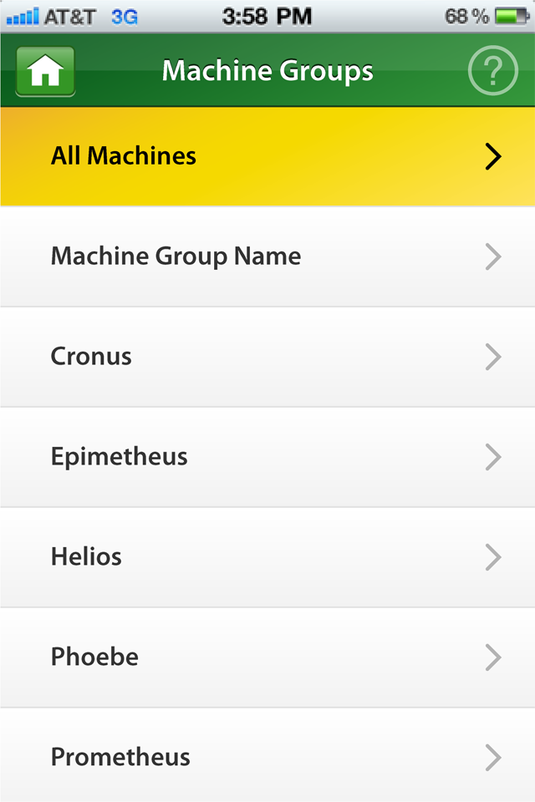
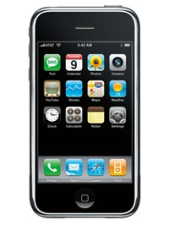
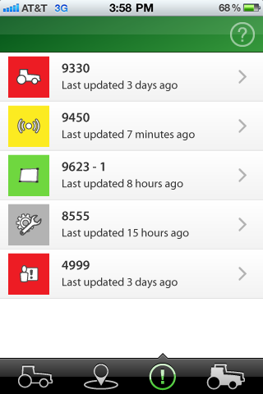
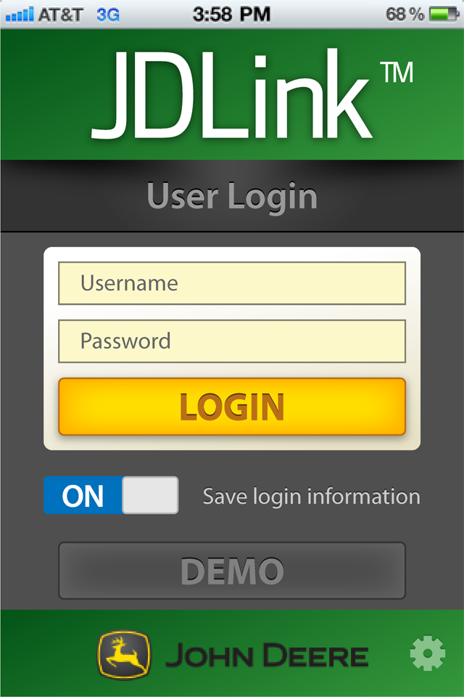
Technology Integration
John Deere FarmSight™ Ready
CAN-Bus Integration
JDLink™ Mobile Apps
Notes:
Let’s talk about a few examples around technology integration.
Conversations & initiatives we can have with ISG
User interface efficiencies, driving commonality and integration across platforms
John Deere FarmSight Ready – providing a plug and play capability for
Reference GreenStar ready & adoption of AutoTrac
Vehicle harness & space claim strategy that supports the implementation of John Deere FarmSight™ strategy and allows dealers to easily install infrastructure hardware to support the John Deere FarmSight™ strategy
As we move into the next coupe of years you will see us working to driving adoption of JDFS technology in all vehicles with a Cab and a CAN-Bus (some 6M’s, all 6R’s, 7R’s, 9R’s, Combines, , Sprayers, SPFH, etc.)
Fuel usage, emissions increases, low coolant alerts, hydraulic issues, diagnostic trouble codes
Can BUS integration – leveraging our relationship with ISG to do what our competitors cant
We can serve up rich machine data much more efficiently and freely due to our relationship with ISG
3. JDLink iPhone App – Dealers & customers have been asking for this and it will be available this fall on iPad and iPhone
Key initial features
Multiple machine mapping
Directions to machines
Ping machines
View and acknowledge alerts
DEMO Account for non JDLink Users

Slide 12
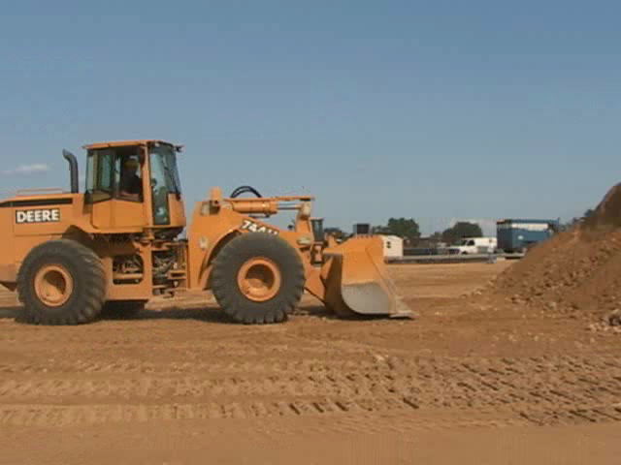
Construction
Operator Assisted Loader

Slide 13
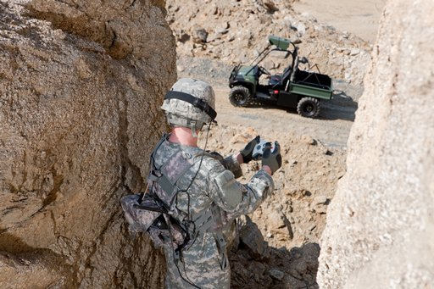
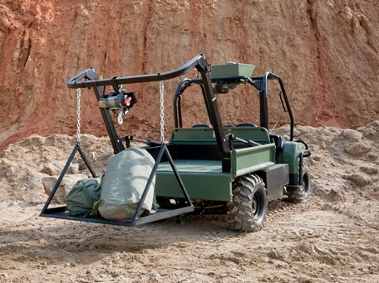
Military and Security Customers
Notes:
-Based off of 825D XUV- Includes ODOA (full 180), perception head like on autonomous tractor (main differences – doesn’t use the 2 cameras required to tell the difference between produce and obstacles), thermal cameras, rear and front cameras (360 view), bed usage to move smaller vehicles or heavy equipment, full e-stop, technology building capabilities
Driven remotely with a joystick
Follow a lead person or vehicle
Traverse a GPS defined route
Repeat a previously driven route
Still manually drivable from the seat
Securities (start at 1:43 minutes in – operation and protect) – (end at 4:19 - end of obstacle detection example with crack/hole in road)

Slide 14
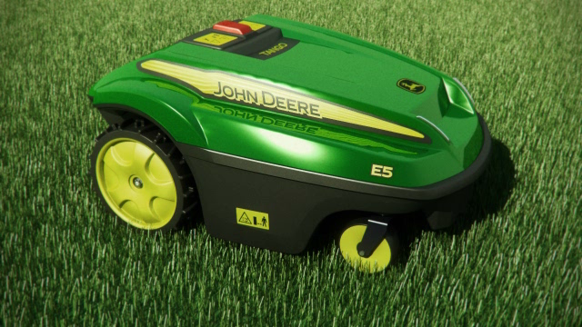
Homeowner Customers
Notes:
Customers: want the yard to look good, don’t like to mow
early adopters
too much to do and to little time
no gasoline needed
no maintenance needed

Slide 15
Notes:
15

